Slide 1
Lecture 13: Attention

Slide 2
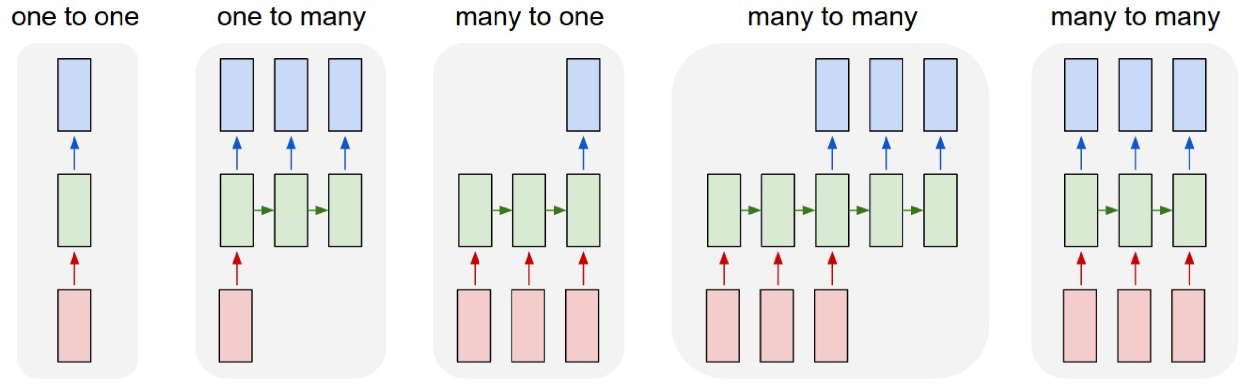
Last Time: Recurrent Neural Networks

Slide 3
Sequence-to-Sequence with RNNs
Input: Sequence x₁, … x_{T} Output: Sequence y₁, …, y_{T’}
Encoder: h_{t} = f_{W}(x_{t}, h_{t-1})
h₁
h₂
h₃
h₄
x₁
x₂
x₃
x₄
we
are
ea$ng
bread
Sutskever et al, “Sequence to sequence learning with neural networks”, NeurIPS 2014

Slide 4
Sequence-to-Sequence with RNNs
Input: Sequence x₁, … x_{T} Output: Sequence y₁, …, y_{T’}
From ﬁnal hidden state predict: Ini0al decoder state s₀ Context vector c (oDen c=h_{T})
Encoder: h_{t} = f_{W}(x_{t}, h_{t-1})
h₁
h₂
h₃
h₄
s₀
x₁
x₂
x₃
x₄
c
we
are
ea$ng
bread
Sutskever et al, “Sequence to sequence learning with neural networks”, NeurIPS 2014

Slide 5
Sequence-to-Sequence with RNNs
Input: Sequence x₁, … x_{T}
Decoder: s_{t} = g_{U}(y_{t-1}, h_{t-1}, c)
Output: Sequence y₁, …, y_{T’}
estamos
From ﬁnal hidden state predict:
Initial decoder state s₀
y₁
Encoder: h = f
(x , h )
t
W t t-1
Context vector c (oDen c=h )
T
h₁
h₂
h₃
h₄
s₀
s₁
x₁
x₂
x₃
x₄
y₀
c
we
are
ea$ng
bread
[START]
Sutskever et al, “Sequence to sequence learning with neural networks”, NeurIPS 2014

Slide 6
Sequence-to-Sequence with RNNs
Input: Sequence x₁, … x_{T}
Decoder: s_{t} = g_{U}(y_{t-1}, h_{t-1}, c)
Output: Sequence y₁, …, y_{T’}
estamos comiendo
From ﬁnal hidden state predict:
Ini0al decoder state s₀
y₁
y₂
Encoder: h = f
(x , h )
t
W t t-1
Context vector c (oDen c=h )
T
h₁
h₂
h₃
h₄
s₀
s₁
s₂
x₁ | x₂ | x₃ | x₄ c | y₀ | y₁
we | are | ea$ng | bread | [START] | estamos
Sutskever et al, “Sequence to sequence learning with neural networks”, NeurIPS 2014

Slide 7
Sequence-to-Sequence with RNNs
Input: Sequence x₁, … x_{T}
Decoder: s_{t} = g_{U}(y_{t-1}, h_{t-1}, c)
Output: Sequence y₁, …, y_{T’}
estamos comiendo pan [STOP]
From ﬁnal hidden state predict:
Ini0al decoder state s₀
y₁
y₂
y₃
y₄
Encoder: h = f
(x , h )
t
W t t-1
Context vector c (oDen c=h )
T
h₁
h₂
h₃
h₄
s₀
s | 4
s₁
s₂
s₃
x₁ | x₂ | x₃ | x₄ c | y₀ | y₁ | y₂ | y₃
we | are | ea$ng | bread | [START] | estamos | comiendo | pan
Sutskever et al, “Sequence to sequence learning with neural networks”, NeurIPS 2014

Slide 8
Sequence-to-Sequence with RNNs
Input: Sequence x₁, … x_{T}
Decoder: s_{t} = g_{U}(y_{t-1}, h_{t-1}, c)
Output: Sequence y₁, …, y_{T’}
estamos comiendo pan [STOP]
From ﬁnal hidden state predict:
Ini0al decoder state s₀
y₁
y₂
y₃
y₄
Encoder: h = f
(x , h )
t
W t t-1
Context vector c (oDen c=h )
T
h₁
h₂
h₃
h₄
s₀
s | 4
s₁
s₂
s₃
x₁
x₂
x₃
x₄
y₀
y₁
y₂
y₃
c
we
are
ea$ng
bread
Problem: Input sequence bo<lenecked through ﬁxed- sized vector. What if T=1000?
[START]
estamos
comiendo
pan
Sutskever et al, “Sequence to sequence learning with neural networks”, NeurIPS 2014
Lecture 13 - 10

Slide 9
Sequence-to-Sequence with RNNs
Input: Sequence x₁, … x_{T}
Decoder: s_{t} = g_{U}(y_{t-1}, h_{t-1}, c)
Output: Sequence y₁, …, y_{T’}
estamos comiendo pan [STOP]
From ﬁnal hidden state predict:
Ini0al decoder state s₀
y₁
y₂
y₃
y₄
Encoder: h = f
(x , h )
t
W t t-1
Context vector c (oDen c=h )
T
h₁
h₂
h₃
h₄
s₀
s | 4
s₁
s₂
s₃
x₁
x₂
x₃
x₄
y₀
y₁
y₂
y₃
c
we
are
ea$ng
bread
Problem: Input sequence bo<lenecked through ﬁxed- sized vector. What if T=1000?
[START] estamos comiendo
Idea: use new context vector
pan
Sutskever et al, “Sequence to sequence learning with neural networks”, NeurIPS 2014
at each step of decoder!
October 23, 2019
Lecture 13 - 11

Slide 10
Sequence-to-Sequence with RNNs and A,en.on
Input: Sequence x₁, … x_{T} Output: Sequence y₁, …, y_{T’}
From ﬁnal hidden state:
Ini0al decoder state s₀
Encoder: h_{t} = f_{W}(x_{t}, h_{t-1})
h₁
h₂
h₃
h₄
s₀
x₁
x₂
x₃
x₄
we
are
ea$ng
bread
Bahdanau et al, “Neural machine transla$on by jointly learning to align and translate”, ICLR 2015

Slide 11
Sequence-to-Sequence with RNNs and A,en.on
Compute (scalar) alignment scores
^{e}t,i ^{= f}aE^{(s}t-1^{, h}i⁾
(f_{aE} is an MLP)
From ﬁnal hidden state:
Ini0al decoder state s₀
^{e}11
^{e}12
^{e}13
^{e}14
h₁
h₂
h₃
h₄
s₀
x₁
x₂
x₃
x₄
we
are
ea$ng
bread
Bahdanau et al, “Neural machine transla$on by jointly learning to align and translate”, ICLR 2015

Slide 12
Sequence-to-Sequence with RNNs and A,en.on
Compute (scalar) alignment scores
ª11
ª12
ª13
ª14
^{e}t,i ^{= f}aE^{(s}t-1^{, h}i⁾
(f_{aE} is an MLP)
Normalize alignment scores to get a<en0on weights 0 < a_{t,i} < 1 ∑_{i}a_{t,i} = 0
soDmax
From ﬁnal hidden state:
Ini0al decoder state s₀
^{e}11
^{e}12
^{e}13
^{e}14
h₁
h₂
h₃
h₄
s₀
x₁
x₂
x₃
x₄
we
are
ea$ng
bread
Bahdanau et al, “Neural machine transla$on by jointly learning to align and translate”, ICLR 2015

Slide 13

Sequence-to-Sequence with RNNs and A,en.on
✖ ✖ ✖ ✖
Compute (scalar) alignment scores
^{e}t,i ^{= f}aE^{(s}t-1^{, h}i⁾
(f_{aE} is an MLP)
ª11
ª12 ª13 ª14 soDmax
^{e}12 ^{e}13 ^{e}14
estamos
Normalize alignment scores to get a<en0on weights
y₁
From ﬁnal hidden state:
0 < a < 1 ∑ a = 0
^{e}11
Ini0al decoder state s
t,i i t,i
0
Compute context vector as linear combina$on of hidden states ^{c}t ^{= ∑}iªt,i^{h}i
s₁
h₁
h₂
h₃
h₄
s₀
+
Use context vector in decoder: s_{t} = g_{U}(y_{t-1}, s_{t-1}, c_{t})
x₁ | x₂ | x₃ | x₄ | c₁ | y₀
we | are | ea$ng | bread
This is all diﬀeren0able! Do not supervise a<en0on weights –
backprop through everything
October 23, 2019
Bahdanau et al, “Neural machine transla$on by jointly learning to align and translate”, ICLR 2015
Lecture 13 - 15

Slide 14
Sequence-to-Sequence with RNNs and A,en.on
✖ ✖ ✖ ✖
Compute (scalar) alignment scores
^{e}t,i ^{= f}aE^{(s}t-1^{, h}i⁾
(f_{aE} is an MLP)
ª11
ª12 ª13 ª14 soDmax
^{e}12 ^{e}13 ^{e}14
Normalize alignment scores to get a<en0on weights 0 < a_{t,i} < 1 ∑_{i}a_{t,i} = 0
Compute context vector as linear combina$on of hidden states ^{c}t ^{= ∑}iªt,i^{h}i
From ﬁnal hidden state:
Ini0al decoder state s₀
^{e}11
h₁
h₂
h₃
h₄
s₀
+
x₁
x₂
x₃
x₄
c₁
we
are
ea$ng
bread
Bahdanau et al, “Neural machine transla$on by jointly learning to align and translate”, ICLR 2015

Slide 15
Sequence-to-Sequence with RNNs and A,en.on
✖ ✖ ✖ ✖
Compute (scalar) alignment scores
^{e}t,i ^{= f}aE^{(s}t-1^{, h}i⁾
(f_{aE} is an MLP)
ª11
ª12 ª13 ª14 soDmax
^{e}12 ^{e}13 ^{e}14
estamos
Normalize alignment scores to get a<en0on weights
y₁
From ﬁnal hidden state:
0 < a_{t,i} < 1 ∑_{i}a_{t,i} = 0
Compute context vector as linear combina$on of hidden states ^{c}t ^{= ∑}iªt,i^{h}i
^{e}11
Ini0al decoder state s
0
s₁
h₁
h₂
h₃
h₄
s₀
+
Intui0on: Context vector aEends to the relevant
Use context vector in decoder: s_{t} = g_{U}(y_{t-1}, s_{t-1}, c_{t})
x₁
x₂
x₃
x₄
c₁
y₀
part of the input sequence
“estamos” = “we are” so maybe a₁₁=a₁₂=0.45, a₁₃=a₁₄=0.05
we
are
ea$ng
bread
This is all diﬀeren0able! Do not supervise a<en0on weights – backprop through everything
Bahdanau et al, “Neural machine transla$on by jointly learning to align and translate”, ICLR 2015

Slide 16
Sequence-to-Sequence with RNNs
Repeat: Use s₁ to compute new context vector c₂
✖ ✖ ✖ ✖
ª21
ª22 ª23 ª24 soDmax
^{e}22 ^{e}23 ^{e}24
estamos
y₁
^{e}21
+
s₁
h₁
h₂
h₃
h₄
s₀
x₁
x₂
x₃
x₄
c₁
y₀
c₂
we
are
ea$ng
bread
[START]
Bahdanau et al, “Neural machine transla$on by jointly learning to align and translate”, ICLR 2015

Slide 17
Sequence-to-Sequence with RNNs and A,en.on
✖ ✖ ✖ ✖
ª21
ª22 ª23 ª24 soDmax
^{e}22 ^{e}23 ^{e}24
estamos comiendo
y₁
y₂
Repeat: Use s₁ to compute new context
^{e}21
vector c
2
+
Use c₂ to compute s₂, y₂
s₁
s₂
h₁
h₂
h₃
h₄
s₀
x₁
x₂
x₃
x₄
c₁
y₀
c₂
y₁
we
are
ea$ng
bread
[START]
estamos
Bahdanau et al, “Neural machine transla$on by jointly learning to align and translate”, ICLR 2015
Lecture 13 - 19

Slide 18
Sequence-to-Sequence with RNNs and A,en.on
✖ ✖ ✖ ✖
ª21
ª22 ª23 ª24 soDmax
^{e}22 ^{e}23 ^{e}24
estamos comiendo
y₁
y₂
Repeat: Use s₁ to compute new context
^{e}21
vector c
2
+
Use c₂ to compute s₂, y₂
s₁
s₂
h₁
h₂
h₃
h₄
s₀
Intui0on: Context vector aEends to the relevant part of the input sequence “comiendo” = “ea0ng” so maybe a₂₁=a₂₄=0.05, a₂₂=0.1, a₂₃=0.8
x₁
x₂
x₃
x₄
c₁
y₀
c₂
y₁
we
are
ea$ng
bread
[START]
estamos
Bahdanau et al, “Neural machine transla$on by jointly learning to align and translate”, ICLR 2015
Lecture 13 - 20

Slide 19
Sequence-to-Sequence with RNNs and A,en.on
Use a diﬀerent context vector in each 0mestep of decoder
Input sequence not bo<lenecked through single vector
At each 0mestep of decoder, context vector “looks at” diﬀerent parts of the input sequence
estamos comiendo pan
[STOP]
y₁
y₂
y₃
y₄
h₁
h₂
h₃
h₄
s₀
s₂
s₄
s₁
s₃
c₁
c₂
c₃
c₄
x₁ | x₂ | x₃ | x₄ | y₀ | y₁ | y₂ | y₃
we | are | ea$ng | bread | [START] | estamos | comiendo | pan
Bahdanau et al, “Neural machine transla$on by jointly learning to align and translate”, ICLR 2015

Slide 20
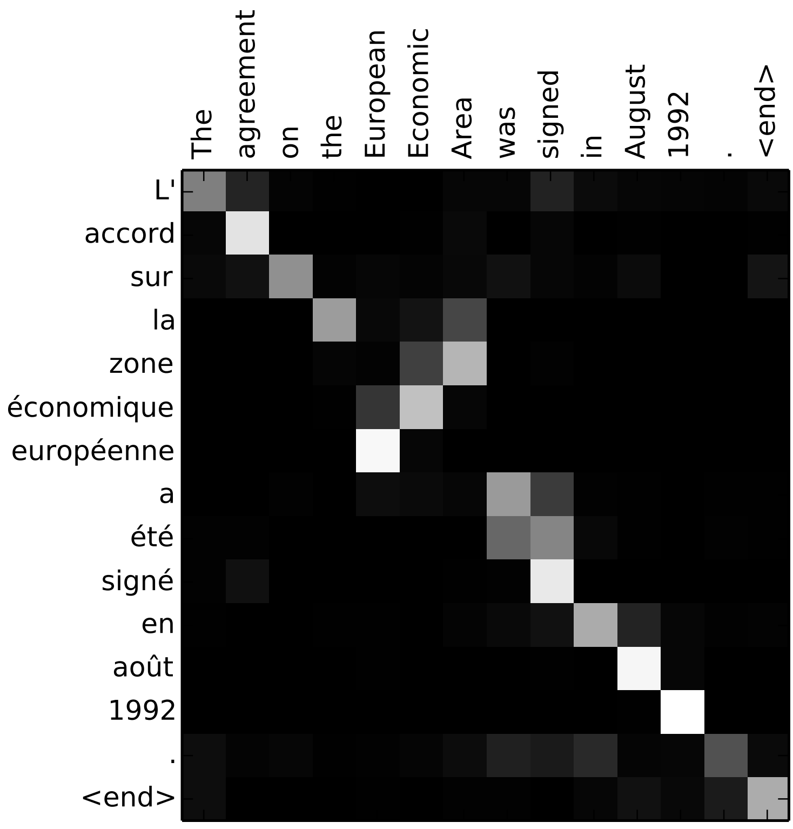
Sequence-to-Sequence with RNNs and A,en.on
Visualize aEen$on weights a_{t,i}
Example: English to French transla$on
Input: “The agreement on the European Economic Area was signed in August 1992.”
Output: “L’accord sur la zone économique européenne a été signé en août 1992.”
Bahdanau et al, “Neural machine transla$on by jointly learning to align and translate”, ICLR 2015

Slide 21
Sequence-to-Sequence with RNNs and A,en.on
Visualize aEen$on weights a_{t,i}
Example: English to French transla$on
Input: “The agreement on the European Economic Area was signed in August 1992.”
Diagonal a<en0on means words correspond in order
Output: “L’accord sur la zone économique européenne a été signé en août 1992.”
Diagonal a<en0on means words correspond in order
Bahdanau et al, “Neural machine transla$on by jointly learning to align and translate”, ICLR 2015

Slide 22
Sequence-to-Sequence with RNNs and A,en.on
Visualize aEen$on weights a_{t,i}
Example: English to French transla$on
Input: “The agreement on the European Economic Area was signed in August 1992.”
Diagonal a<en0on means words correspond in order
A<en0on ﬁgures out diﬀerent word orders
Output: “L’accord sur la zone économique européenne a été signé en août 1992.”
Diagonal a<en0on means words correspond in order
Bahdanau et al, “Neural machine transla$on by jointly learning to align and translate”, ICLR 2015

Slide 23
Sequence-to-Sequence with RNNs and A,en.on
Visualize aEen$on weights a_{t,i}
Example: English to French transla$on
Input: “The agreement on the European Economic Area was signed in August 1992.”
Diagonal a<en0on means words correspond in order
A<en0on ﬁgures out diﬀerent word orders
Output: “L’accord sur la zone économique européenne a été signé en août 1992.”
Verb conjuga0on
Diagonal a<en0on means words correspond in order
Bahdanau et al, “Neural machine transla$on by jointly learning to align and translate”, ICLR 2015

Slide 24
Sequence-to-Sequence with RNNs and A,en.on
The decoder doesn’t use the fact that h_{i} form an ordered sequence – it just
treats them as an unordered set {h_{i}}
estamos comiendo pan
[STOP]
Can use similar architecture given any
y₁
y₂
y₃
y₄
set of input hidden vectors {h }!
i
h₁
h₂
h₃
h₄
s₀
s₂
s₄
s₁
s₃
c₁
c₂
c₃
c₄
x₁ | x₂ | x₃ | x₄ | y₀ | y₁ | y₂ | y₃
we | are | ea$ng | bread | [START] | estamos | comiendo | pan
Bahdanau et al, “Neural machine transla$on by jointly learning to align and translate”, ICLR 2015

Slide 25
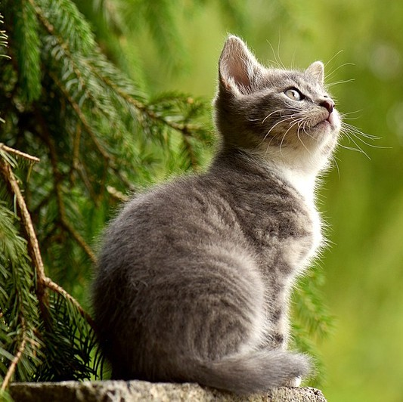
Image Cap.oning with RNNs and A,en.on
^{h}1,1 | ^{h}1,2 | ^{h}1,3
^{h}2,1 | ^{h}2,2 | ^{h}2,3
^{h}3,1 | ^{h}3,2 | ^{h}3,3
s₀
CNN
Use a CNN to compute a grid of features for an image
Cat image is free to use under the Pixabay License
Xu et al, “Show, AEend, and Tell: Neural Image Cap$on Genera$on with Visual AEen$on”, ICML 2015
Lecture 13 - 27

Slide 26
Image Cap.oning with RNNs and A,en.on
Alignment scores
^{e}t,i,j ^{= f}aE^{(s}t-1^{, h}i,j⁾
^{e}1,1,1 | ^{e}1,1,2 | ^{e}1,1,3
^{e}1,2,1 | ^{e}1,2,2 | ^{e}1,2,3
^{e}1,3,1 | ^{e}1,3,2 | ^{e}1,3,3
^{h}1,1 | ^{h}1,2 | ^{h}1,3
^{h}2,1 | ^{h}2,2 | ^{h}2,3
^{h}3,1 | ^{h}3,2 | ^{h}3,3
s₀
CNN
Use a CNN to compute a grid of features for an image
Xu et al, “Show, AEend, and Tell: Neural Image Cap$on Genera$on with Visual AEen$on”, ICML 2015

Slide 27
Image Cap.oning with RNNs and A,en.on
Alignment scores AEen$on weights
^{e}t,i,j ^{= f}aE^{(s}t-1^{, h}i,j⁾ a_{t,:,:} = soDmax(e_{t,:,:})
^{e}1,1,1 | ^{e}1,1,2 | ^{e}1,1,3
^{e}1,2,1 | ^{e}1,2,2 | ^{e}1,2,3
^{e}1,3,1 | ^{e}1,3,2 | ^{e}1,3,3
ª1,1,1 | ª1,1,2 | ª1,1,3
ª1,2,1 | ª1,2,2 | ª1,2,3
ª1,3,1 | ª1,3,2 | ª1,3,3
soDmax
^{h}1,1 | ^{h}1,2 | ^{h}1,3
^{h}2,1 | ^{h}2,2 | ^{h}2,3
^{h}3,1 | ^{h}3,2 | ^{h}3,3
s₀
CNN
Use a CNN to compute a grid of features for an image
Xu et al, “Show, AEend, and Tell: Neural Image Cap$on Genera$on with Visual AEen$on”, ICML 2015

Slide 28
Image Cap.oning with RNNs and A,en.on
Alignment scores AEen$on weights
^{e}t,i,j ^{= f}aE^{(s}t-1^{, h}i,j⁾
^{e}1,1,1 | ^{e}1,1,2 | ^{e}1,1,3
^{e}1,2,1 | ^{e}1,2,2 | ^{e}1,2,3
^{e}1,3,1 | ^{e}1,3,2 | ^{e}1,3,3
ª1,1,1 | ª1,1,2 | ª1,1,3
ª1,2,1 | ª1,2,2 | ª1,2,3
ª1,3,1 | ª1,3,2 | ª1,3,3
a = soDmax(e )
soDmax
t,:,: t,:,:
^{c}t ^{= ∑}i,jªt,i,j^{h}i,j
^{h}1,1 | ^{h}1,2 | ^{h}1,3
^{h}2,1 | ^{h}2,2 | ^{h}2,3
^{h}3,1 | ^{h}3,2 | ^{h}3,3
s₀
CNN
c₁
Use a CNN to compute a grid of features for an image
Xu et al, “Show, AEend, and Tell: Neural Image Cap$on Genera$on with Visual AEen$on”, ICML 2015
Lecture 13 - 30

Slide 29
Image Cap.oning with RNNs and A,en.on
Alignment scores AEen$on weights
^{e}t,i,j ^{= f}aE^{(s}t-1^{, h}i,j⁾
^{e}1,1,1 | ^{e}1,1,2 | ^{e}1,1,3
^{e}1,2,1 | ^{e}1,2,2 | ^{e}1,2,3
^{e}1,3,1 | ^{e}1,3,2 | ^{e}1,3,3
ª1,1,1 | ª1,1,2 | ª1,1,3
ª1,2,1 | ª1,2,2 | ª1,2,3
ª1,3,1 | ª1,3,2 | ª1,3,3
a = soDmax(e )
soDmax
cat
t,:,: t,:,:
^{c}t ^{= ∑}i,jªt,i,j^{h}i,j
y₁
^{h}1,1 | ^{h}1,2 | ^{h}1,3
^{h}2,1 | ^{h}2,2 | ^{h}2,3
^{h}3,1 | ^{h}3,2 | ^{h}3,3
s₀
CNN
s₁
c₁
y₀
Use a CNN to compute a grid of features for an image
[START]
Xu et al, “Show, AEend, and Tell: Neural Image Cap$on Genera$on with Visual AEen$on”, ICML 2015

Slide 30
Image Cap.oning with RNNs and A,en.on
^{e}t,i,j ^{= f}aE^{(s}t-1^{, h}i,j⁾
a_{t,:,:} = soDmax(e_{t,:,:}) ^{c}t ^{= ∑}i,jªt,i,j^{h}i,j
cat
y₁
^{h}1,1 | ^{h}1,2 | ^{h}1,3
^{h}2,1 | ^{h}2,2 | ^{h}2,3
^{h}3,1 | ^{h}3,2 | ^{h}3,3
s₀
CNN
s₁
c₁
y₀
Use a CNN to compute a grid of features for an image
[START]
Xu et al, “Show, AEend, and Tell: Neural Image Cap$on Genera$on with Visual AEen$on”, ICML 2015

Slide 31
Image Cap.oning with RNNs and A,en.on
Alignment scores
^{e}t,i,j ^{= f}aE^{(s}t-1^{, h}i,j⁾ a_{t,:,:} = soDmax(e_{t,:,:})
^{c}t ^{= ∑}i,jªt,i,j^{h}i,j
^{e}2,1,1 | ^{e}2,1,2 | ^{e}2,1,3
^{e}2,2,1 | ^{e}2,2,2 | ^{e}2,2,3
^{e}2,3,1 | ^{e}2,3,2 | ^{e}2,3,3
cat
y₁
^{h}1,1 | ^{h}1,2 | ^{h}1,3
^{h}2,1 | ^{h}2,2 | ^{h}2,3
^{h}3,1 | ^{h}3,2 | ^{h}3,3
s₀
CNN
s₁
c₁
y₀
Use a CNN to compute a grid of features for an image
[START]
Xu et al, “Show, AEend, and Tell: Neural Image Cap$on Genera$on with Visual AEen$on”, ICML 2015

Slide 32
Image Cap.oning with RNNs and A,en.on
Alignment scores AEen$on weights
^{e}t,i,j ^{= f}aE^{(s}t-1^{, h}i,j⁾
^{e}2,1,1 | ^{e}2,1,2 | ^{e}2,1,3
^{e}2,2,1 | ^{e}2,2,2 | ^{e}2,2,3
^{e}2,3,1 | ^{e}2,3,2 | ^{e}2,3,3
ª2,1,1 | ª2,1,2 | ª2,1,3
ª2,2,1 | ª2,2,2 | ª2,2,3
ª2,3,1 | ª2,3,2 | ª2,3,3
a = soDmax(e )
soDmax
cat
t,:,: t,:,:
^{c}t ^{= ∑}i,jªt,i,j^{h}i,j
y₁
^{h}1,1 | ^{h}1,2 | ^{h}1,3
^{h}2,1 | ^{h}2,2 | ^{h}2,3
^{h}3,1 | ^{h}3,2 | ^{h}3,3
s₀
CNN
s₁
c₁
y₀
Use a CNN to compute a grid of features for an image
[START]
Xu et al, “Show, AEend, and Tell: Neural Image Cap$on Genera$on with Visual AEen$on”, ICML 2015

Slide 33
Image Cap.oning with RNNs and A,en.on
Alignment scores AEen$on weights
^{e}t,i,j ^{= f}aE^{(s}t-1^{, h}i,j⁾
^{e}2,1,1 | ^{e}2,1,2 | ^{e}2,1,3
^{e}2,2,1 | ^{e}2,2,2 | ^{e}2,2,3
^{e}2,3,1 | ^{e}2,3,2 | ^{e}2,3,3
ª2,1,1 | ª2,1,2 | ª2,1,3
ª2,2,1 | ª2,2,2 | ª2,2,3
ª2,3,1 | ª2,3,2 | ª2,3,3
a = soDmax(e )
soDmax
cat
t,:,: t,:,:
^{c}t ^{= ∑}i,jªt,i,j^{h}i,j
y₁
^{h}1,1 | ^{h}1,2 | ^{h}1,3
^{h}2,1 | ^{h}2,2 | ^{h}2,3
^{h}3,1 | ^{h}3,2 | ^{h}3,3
s₀
CNN
s₁
c₁
y₀
c₂
Use a CNN to compute a grid of features for an image
[START]
Xu et al, “Show, AEend, and Tell: Neural Image Cap$on Genera$on with Visual AEen$on”, ICML 2015

Slide 34
Image Cap.oning with RNNs and A,en.on
Alignment scores AEen$on weights
^{e}t,i,j ^{= f}aE^{(s}t-1^{, h}i,j⁾
^{e}2,1,1 | ^{e}2,1,2 | ^{e}2,1,3
^{e}2,2,1 | ^{e}2,2,2 | ^{e}2,2,3
^{e}2,3,1 | ^{e}2,3,2 | ^{e}2,3,3
ª2,1,1 | ª2,1,2 | ª2,1,3
ª2,2,1 | ª2,2,2 | ª2,2,3
ª2,3,1 | ª2,3,2 | ª2,3,3
a = soDmax(e )
soDmax
cat
sivng
t,:,: t,:,:
^{c}t ^{= ∑}i,jªt,i,j^{h}i,j
y₁
y₂
^{h}1,1 | ^{h}1,2 | ^{h}1,3
^{h}2,1 | ^{h}2,2 | ^{h}2,3
^{h}3,1 | ^{h}3,2 | ^{h}3,3
s₀
s₂
CNN
s₁
c₁
y₀
c₂
y₁
Use a CNN to compute a grid of features for an image
[START]
cat
Xu et al, “Show, AEend, and Tell: Neural Image Cap$on Genera$on with Visual AEen$on”, ICML 2015

Slide 35
Image Cap.oning with RNNs and A,en.on
Each $mestep of decoder
e = f (s , h )
t,i,j aE t-1 i,j
uses a diﬀerent context vector that looks at diﬀerent parts of the input image
a_{t,:,:} = soDmax(e_{t,:,:})
cat sivng
outside
[STOP]
c = ∑ a h
y₁
y₂
y₃
y₄
t i,j t,i,j i,j
^{h}1,1 | ^{h}1,2 | ^{h}1,3
^{h}2,1 | ^{h}2,2 | ^{h}2,3
^{h}3,1 | ^{h}3,2 | ^{h}3,3
s₀
s₂
s₄
CNN
s₁
s₃
c₁
y₀
c₂
y₁
c₃
y₂
c₄
y₃
Use a CNN to compute a grid of features for an image
[START]
cat
sivng
outside
Xu et al, “Show, AEend, and Tell: Neural Image Cap$on Genera$on with Visual AEen$on”, ICML 2015

Slide 36
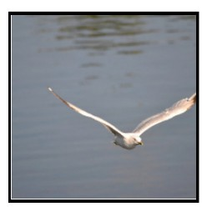
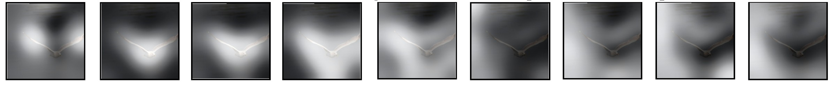
Image Cap.oning with RNNs and A,en.on
Xu et al, “Show, AEend, and Tell: Neural Image Cap$on Genera$on with Visual AEen$on”, ICML 2015

Slide 37
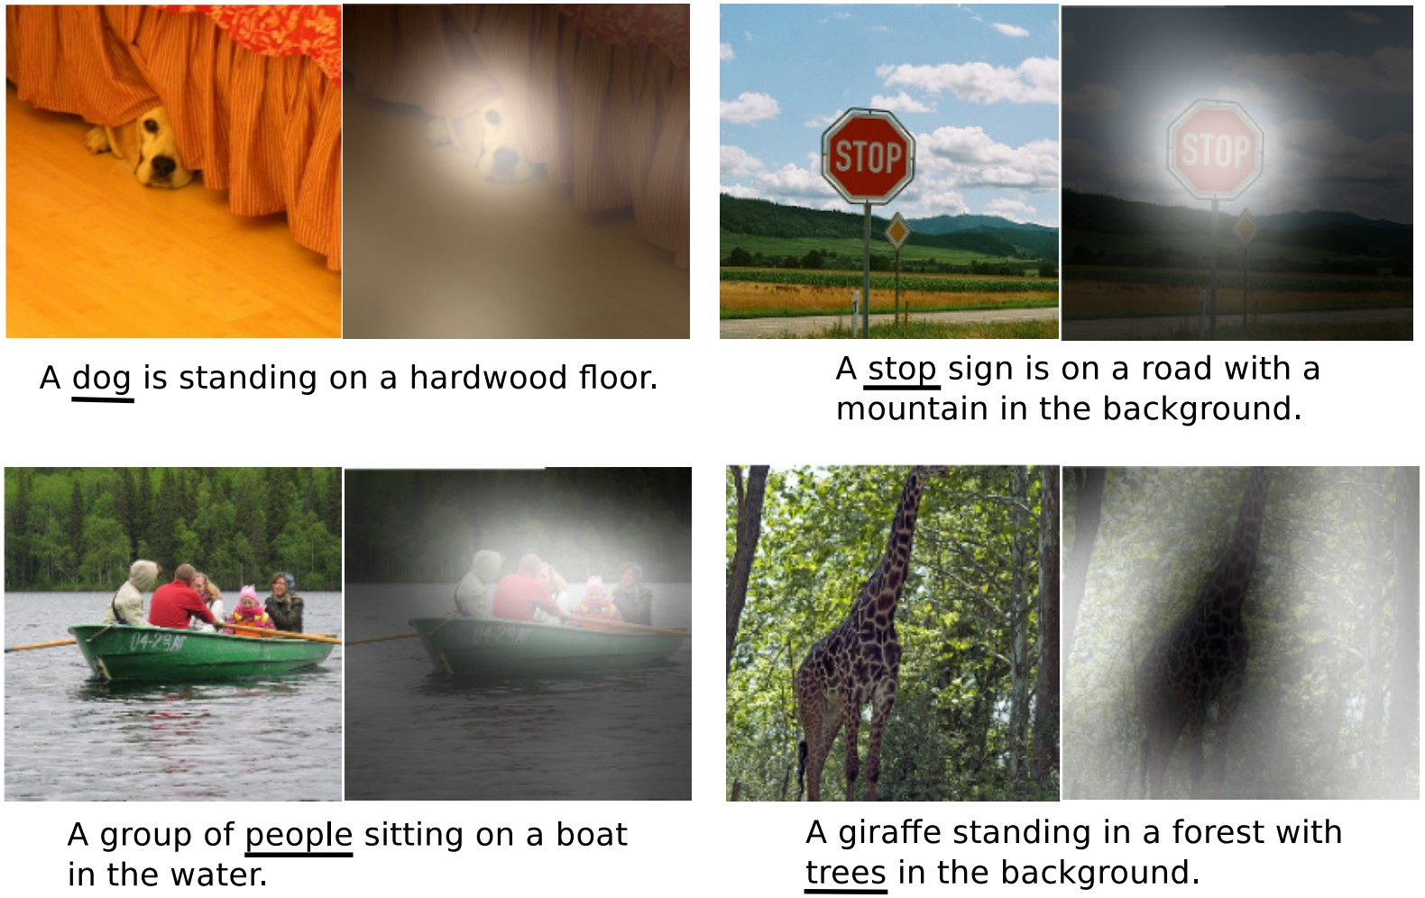
Image Cap.oning with RNNs and A,en.on
Xu et al, “Show, AEend, and Tell: Neural Image Cap$on Genera$on with Visual AEen$on”, ICML 2015

Slide 38
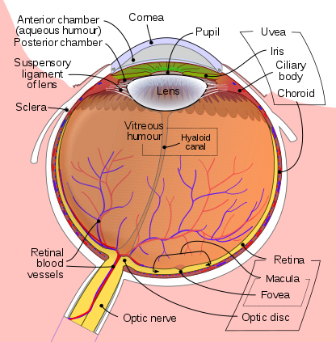
Human Vision: Fovea
Light enters eye
Re0na
detects light
Acuity graph is licensed under CC A-SA 3.0 Unported
Lecture 13 - 40

Slide 39
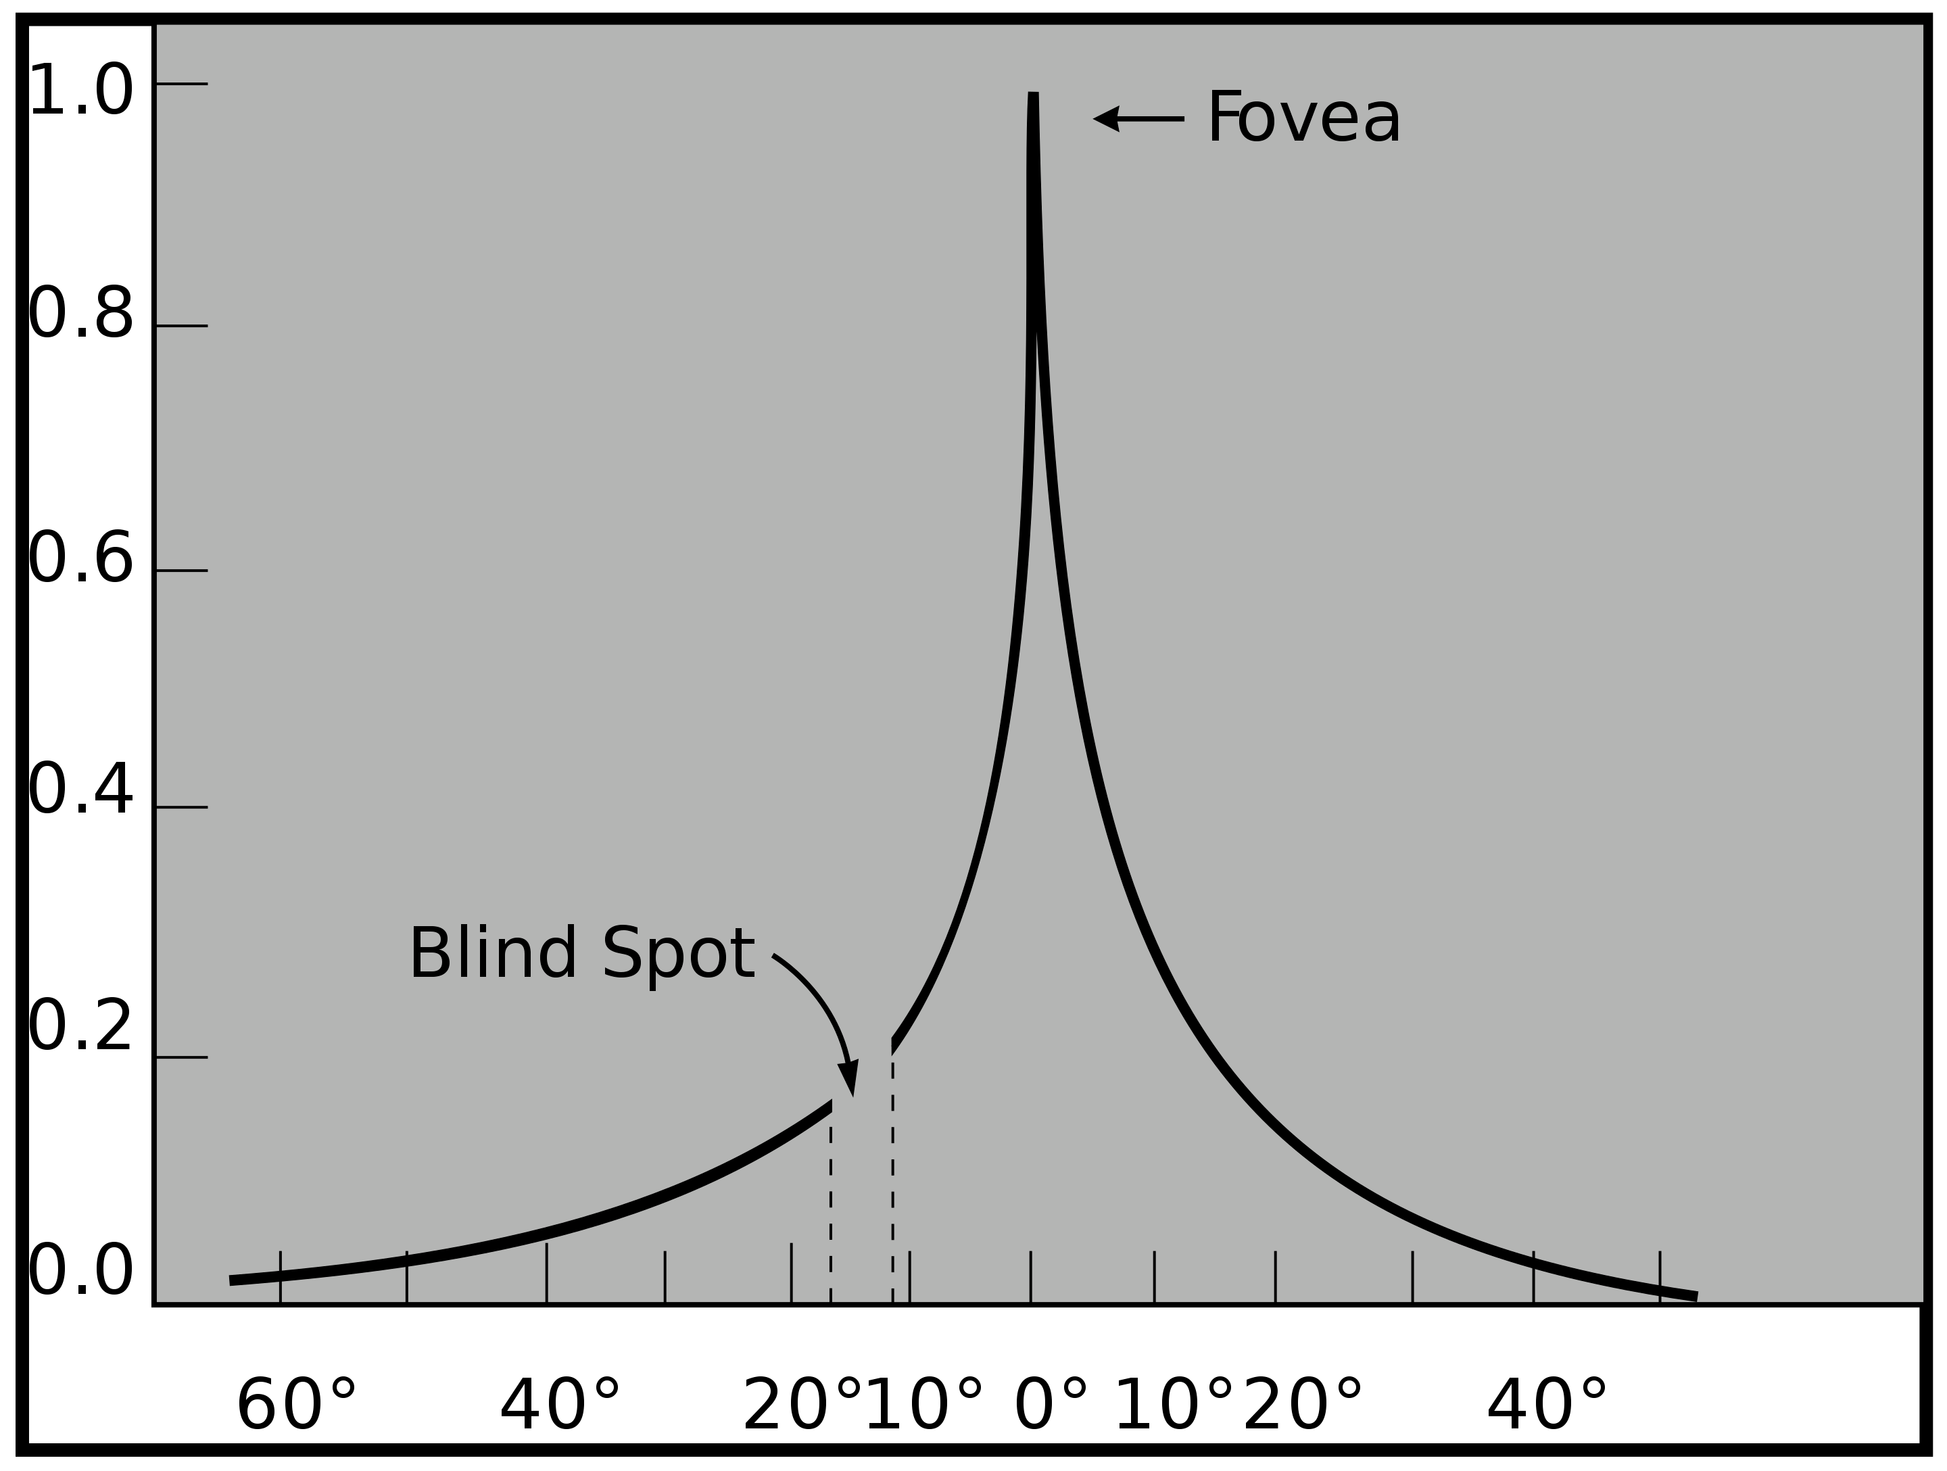
Human Vision: Fovea
The fovea is a $ny region of the re$na that can see with high acuity
Light enters eye
Re0na
detects light
Eye image is licensed under CC A-SA 3.0 Unported (added black arrow, green arc, and white circle)
Acuity graph is licensed under CC A-SA 3.0 Unported (No changes made)
Lecture 13 - 41

Slide 40
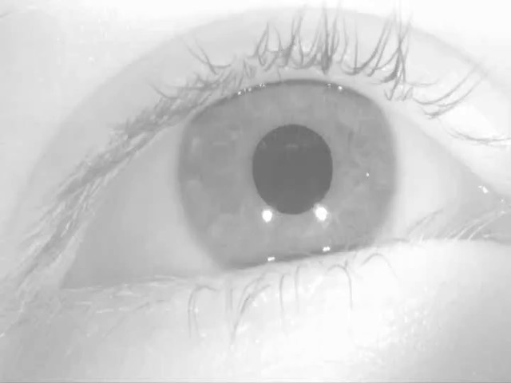
Human Vision: Saccades
The fovea is a $ny region of the re$na that can see with high acuity
Human eyes are constantly moving so we don’t no$ce
Saccade video is licensed under CC A-SA 4.0 Interna$onal (no changes made)
Acuity graph is licensed under CC A-SA 3.0 Unported (No changes made)
Lecture 13 - 42

Slide 41
Image Cap.oning with RNNs and A,en.on
AEen$on weights at each
$mestep kind of like saccades of human eye
Xu et al, “Show, AEend, and Tell: Neural Image Cap$on Genera$on with Visual AEen$on”, ICML 2015
Saccade video is licensed under CC A-SA 4.0 Interna$onal (no changes made)

Slide 42
X, A,end, and Y
“Show, a<end, and tell” (Xu et al, ICML 2015)
Look at image, aEend to image regions, produce ques$on
“Ask, a<end, and answer” (Xu and Saenko, ECCV 2016) “Show, ask, a<end, and answer” (Kazemi and Elqursh, 2017) Read text of ques$on, aEend to image regions, produce answer
“Listen, a<end, and spell” (Chan et al, ICASSP 2016)
Process raw audio, aEend to audio regions while producing text
“Listen, a<end, and walk” (Mei et al, AAAI 2016)
Process text, aEend to text regions, output naviga$on commands
“Show, a<end, and interact” (Qureshi et al, ICRA 2017)
Process image, aEend to image regions, output robot control commands
“Show, a<end, and read” (Li et al, AAAI 2019) Process image, aEend to image regions, output text

Slide 43
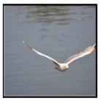
A,en.on Layer
Alignment scores
Attention weights
^{e}t,i,j ^{= f}att^{(s}t-1^{, h}i,j⁾ a_{t,:,:} = softmax(e_{t,:,:})
^{c}t ^{= ∑}i,jªt,i,j^{h}i,j
^{e}2,1,1 | ^{e}2,1,2 | ^{e}2,1,3
^{e}2,2,1 | ^{e}2,2,2 | ^{e}2,2,3
^{e}2,3,1 | ^{e}2,3,2 | ^{e}2,3,3
ª2,1,1 | ª2,1,2 | ª2,1,3
ª2,2,1 | ª2,2,2 | ª2,2,3
ª2,3,1 | ª2,3,2 | ª2,3,3
softmax
seagull
Inputs:
Query vector: q (Shape: D_{Q})
y₁
^{h}1,1 | ^{h}1,2 | ^{h}1,3
^{h}2,1 | ^{h}2,2 | ^{h}2,3
^{h}3,1 | ^{h}3,2 | ^{h}3,3
CNN
s₀
s₁
Similarity func0on: f_{aE}
c₁
y₀
c₂
[START]
Computa0on:
Similari0es: e (Shape: N_{X}) e_{i} = f_{aE}(q, X_{i})
A<en0on weights: a = soDmax(e) (Shape: N_{X})
Output vector: y = ∑_{i}a_{i}X_{i} (Shape: D_{X})

Slide 44
A,en.on Layer
Alignment scores
Attention weights
^{e}t,i,j ^{= f}att^{(s}t-1^{, h}i,j⁾ a_{t,:,:} = softmax(e_{t,:,:})
^{c}t ^{= ∑}i,jªt,i,j^{h}i,j
^{e}2,1,1 | ^{e}2,1,2 | ^{e}2,1,3
^{e}2,2,1 | ^{e}2,2,2 | ^{e}2,2,3
^{e}2,3,1 | ^{e}2,3,2 | ^{e}2,3,3
ª2,1,1 | ª2,1,2 | ª2,1,3
ª2,2,1 | ª2,2,2 | ª2,2,3
ª2,3,1 | ª2,3,2 | ª2,3,3
softmax
seagull
Inputs:
Query vector: q (Shape: D_{Q})
Similarity func0on: dot product
y₁
^{h}1,1 | ^{h}1,2 | ^{h}1,3
^{h}2,1 | ^{h}2,2 | ^{h}2,3
^{h}3,1 | ^{h}3,2 | ^{h}3,3
CNN
s₀
s₁
c₁
y₀
c₂
[START]
Computa0on:
Similari0es: e (Shape: N_{X}) e_{i} = q · X_{i}
Changes:
A<en0on weights: a = soDmax(e) (Shape: N_{X})
- Use dot product for similarity
Output vector: y = ∑_{i}a_{i}X_{i} (Shape: D_{X})

Slide 45
A,en.on Layer
Alignment scores
Attention weights
^{e}t,i,j ^{= f}att^{(s}t-1^{, h}i,j⁾ a_{t,:,:} = softmax(e_{t,:,:})
^{c}t ^{= ∑}i,jªt,i,j^{h}i,j
^{e}2,1,1 | ^{e}2,1,2 | ^{e}2,1,3
^{e}2,2,1 | ^{e}2,2,2 | ^{e}2,2,3
^{e}2,3,1 | ^{e}2,3,2 | ^{e}2,3,3
ª2,1,1 | ª2,1,2 | ª2,1,3
ª2,2,1 | ª2,2,2 | ª2,2,3
ª2,3,1 | ª2,3,2 | ª2,3,3
softmax
seagull
Inputs:
Query vector: q (Shape: D_{Q})
Similarity func0on: scaled dot product
y₁
^{h}1,1 | ^{h}1,2 | ^{h}1,3
^{h}2,1 | ^{h}2,2 | ^{h}2,3
^{h}3,1 | ^{h}3,2 | ^{h}3,3
CNN
s₀
s₁
c₁
y₀
c₂
[START]
Computa0on: Similari0es: e (Shape: N_{X})
e_{i} = q · X_{i} / sqrt(D_{Q})
Changes:
A<en0on weights: a = soDmax(e) (Shape: N_{X})
- Use scaled dot product for similarity
Output vector: y = ∑_{i}a_{i}X_{i} (Shape: D_{X})

Slide 46
A,en.on Layer
Alignment scores
Attention weights
^{e}t,i,j ^{= f}att^{(s}t-1^{, h}i,j⁾ a_{t,:,:} = softmax(e_{t,:,:})
^{c}t ^{= ∑}i,jªt,i,j^{h}i,j
^{e}2,1,1 | ^{e}2,1,2 | ^{e}2,1,3
^{e}2,2,1 | ^{e}2,2,2 | ^{e}2,2,3
^{e}2,3,1 | ^{e}2,3,2 | ^{e}2,3,3
ª2,1,1 | ª2,1,2 | ª2,1,3
ª2,2,1 | ª2,2,2 | ª2,2,3
ª2,3,1 | ª2,3,2 | ª2,3,3
softmax
seagull
Inputs:
Query vector: q (Shape: D_{Q})
Similarity func0on: scaled dot product
Large similari$es will cause soDmax to saturate and give vanishing gradients Recall a · b = |a||b| cos(angle)
Suppose that a and b are constant vectors of dimension D
Then |a| = (∑_{i}a²)^{1/2} = a sqrt(D)
y₁
^{h}1,1 | ^{h}1,2 | ^{h}1,3
^{h}2,1 | ^{h}2,2 | ^{h}2,3
^{h}3,1 | ^{h}3,2 | ^{h}3,3
CNN
s₀
s₁
c₁
y₀
c₂
[START]
Computa0on:
Similari0es: e (Shape: N_{X}) e_{i} = q · X_{i} / sqrt(D_{Q})
Changes:
A<en0on weights: a = soDmax(e) (Shape: N_{X})
- Use scaled dot product for similarity
Output vector: y = ∑_{i}a_{i}X_{i} (Shape: D_{X})

Slide 47
A,en.on Layer
Alignment scores
Attention weights
^{e}t,i,j ^{= f}att^{(s}t-1^{, h}i,j⁾ a_{t,:,:} = softmax(e_{t,:,:})
^{c}t ^{= ∑}i,jªt,i,j^{h}i,j
^{e}2,1,1 | ^{e}2,1,2 | ^{e}2,1,3
^{e}2,2,1 | ^{e}2,2,2 | ^{e}2,2,3
^{e}2,3,1 | ^{e}2,3,2 | ^{e}2,3,3
ª2,1,1 | ª2,1,2 | ª2,1,3
ª2,2,1 | ª2,2,2 | ª2,2,3
ª2,3,1 | ª2,3,2 | ª2,3,3
softmax
seagull
Inputs:
y₁
Query vectors: Q (Shape: N_{Q} x D_{Q})
^{h}1,1 | ^{h}1,2 | ^{h}1,3
^{h}2,1 | ^{h}2,2 | ^{h}2,3
^{h}3,1 | ^{h}3,2 | ^{h}3,3
CNN
s₀
s₁
c₁
y₀
c₂
[START]
Computa0on:
Similari0es: E = QX^{T} (Shape: N_{Q} x N_{X}) E_{i,j} = Q_{i} · X_{j} / sqrt(D_{Q}) A<en0on weights: A = soDmax(E, dim=1) (Shape: N_{Q} x N_{X}) Output vectors: Y = AX (Shape: N_{Q} x D_{X}) Y_{i} = ∑_{j}A_{i,j}X_{j}
Changes:
Use dot product for similarity
Mul$ple query vectors

Slide 48
A,en.on Layer
Alignment scores
Attention weights
^{e}t,i,j ^{= f}att^{(s}t-1^{, h}i,j⁾ a_{t,:,:} = softmax(e_{t,:,:})
^{c}t ^{= ∑}i,jªt,i,j^{h}i,j
^{e}2,1,1 | ^{e}2,1,2 | ^{e}2,1,3
^{e}2,2,1 | ^{e}2,2,2 | ^{e}2,2,3
^{e}2,3,1 | ^{e}2,3,2 | ^{e}2,3,3
ª2,1,1 | ª2,1,2 | ª2,1,3
ª2,2,1 | ª2,2,2 | ª2,2,3
ª2,3,1 | ª2,3,2 | ª2,3,3
softmax
seagull
Inputs:
Query vectors: Q (Shape: N_{Q} x D_{Q})
y₁
^{h}1,1 | ^{h}1,2 | ^{h}1,3
^{h}2,1 | ^{h}2,2 | ^{h}2,3
^{h}3,1 | ^{h}3,2 | ^{h}3,3
CNN
s₀
s₁
Key matrix: W_{K} (Shape: D_{X} x D_{Q}) Value matrix: W_{V} (Shape: D_{X} x D_{V})
c₁
y₀
c₂
[START]
Computa0on:
Key vectors: K = XW_{K} (Shape: N_{X} x D_{Q})
Value Vectors: V = XW_{V} (Shape: N_{X} x D_{V})
Similari0es: E = QK^{T} (Shape: N_{Q} x N_{X}) E_{i,j} = Q_{i} · K_{j} / sqrt(D_{Q}) A<en0on weights: A = soDmax(E, dim=1) (Shape: N_{Q} x N_{X}) Output vectors: Y = AV (Shape: N_{Q} x D_{V}) Y_{i} = ∑_{j}A_{i,j}V_{j}
Changes:
Use dot product for similarity
Mul$ple query vectors
Separate key and value
Lecture 13 - 50

Slide 49
A,en.on Layer
Inputs:
Query vectors: Q (Shape: N_{Q} x D_{Q}) Input vectors: X (Shape: N_{X} x D_{X}) Key matrix: W_{K} (Shape: D_{X} x D_{Q}) Value matrix: W_{V} (Shape: D_{X} x D_{V})
Computa0on:
Key vectors: K = XW_{K} (Shape: N_{X} x D_{Q})
Value Vectors: V = XW_{V} (Shape: N_{X} x D_{V})
Similari0es: E = QK^{T} (Shape: N_{Q} x N_{X}) E_{i,j} = Q_{i} · K_{j} / sqrt(D_{Q}) A<en0on weights: A = soDmax(E, dim=1) (Shape: N_{Q} x N_{X}) Output vectors: Y = AV (Shape: N_{Q} x D_{V}) Y_{i} = ∑_{j}A_{i,j}V_{j}
X₁
X₂
X₃
Q₁
Q₂
Q₃
Q₄

Slide 50
A,en.on Layer
Inputs:
Query vectors: Q (Shape: N_{Q} x D_{Q}) Input vectors: X (Shape: N_{X} x D_{X}) Key matrix: W_{K} (Shape: D_{X} x D_{Q}) Value matrix: W_{V} (Shape: D_{X} x D_{V})
Computa0on:
Key vectors: K = XW_{K} (Shape: N_{X} x D_{Q})
Value Vectors: V = XW_{V} (Shape: N_{X} x D_{V})
Similari0es: E = QK^{T} (Shape: N_{Q} x N_{X}) E_{i,j} = Q_{i} · K_{j} / sqrt(D_{Q}) A<en0on weights: A = soDmax(E, dim=1) (Shape: N_{Q} x N_{X}) Output vectors: Y = AV (Shape: N_{Q} x D_{V}) Y_{i} = ∑_{j}A_{i,j}V_{j}
X₁
K₁
X₂
K₂
X₃
K₃
Q₁
Q₂
Q₃
Q₄

Slide 51
A,en.on Layer
Inputs:
Query vectors: Q (Shape: N_{Q} x D_{Q}) Input vectors: X (Shape: N_{X} x D_{X}) Key matrix: W_{K} (Shape: D_{X} x D_{Q}) Value matrix: W_{V} (Shape: D_{X} x D_{V})
Computa0on:
X₁
K₁
^{E}1,1
^{E}2,1
^{E}3,1
^{E}4,1
Key vectors: K = XW_{K} (Shape: N_{X} x D_{Q})
Value Vectors: V = XW_{V} (Shape: N_{X} x D_{V})
Similari0es: E = QK^{T} (Shape: N_{Q} x N_{X}) E_{i,j} = Q_{i} · K_{j} / sqrt(D_{Q}) A<en0on weights: A = soDmax(E, dim=1) (Shape: N_{Q} x N_{X}) Output vectors: Y = AV (Shape: N_{Q} x D_{V}) Y_{i} = ∑_{j}A_{i,j}V_{j}
X₂
K₂
^{E}1,2
^{E}2,2
^{E}3,2
^{E}4,2
X₃
K₃
^{E}1,3
^{E}2,3
^{E}3,3
^{E}4,3
Q₁
Q₂
Q₃
Q₄

Slide 52
A,en.on Layer
Inputs:
Query vectors: Q (Shape: N_{Q} x D_{Q}) Input vectors: X (Shape: N_{X} x D_{X}) Key matrix: W_{K} (Shape: D_{X} x D_{Q}) Value matrix: W_{V} (Shape: D_{X} x D_{V})
^{A}1,1
^{A}2,1
^{A}3,1
^{A}4,1
^{A}1,2
^{A}2,2
^{A}3,2
^{A}4,2
^{A}1,3
^{A}2,3
^{A}3,3
^{A}4,3
SoDmax( )
Computa0on:
X₁
K₁
^{E}1,1
^{E}2,1
^{E}3,1
^{E}4,1
Key vectors: K = XW_{K} (Shape: N_{X} x D_{Q})
Value Vectors: V = XW_{V} (Shape: N_{X} x D_{V})
Similari0es: E = QK^{T} (Shape: N_{Q} x N_{X}) E_{i,j} = Q_{i} · K_{j} / sqrt(D_{Q}) A<en0on weights: A = soDmax(E, dim=1) (Shape: N_{Q} x N_{X}) Output vectors: Y = AV (Shape: N_{Q} x D_{V}) Y_{i} = ∑_{j}A_{i,j}V_{j}
X₂
K₂
^{E}1,2
^{E}2,2
^{E}3,2
^{E}4,2
X₃
K₃
^{E}1,3
^{E}2,3
^{E}3,3
^{E}4,3
Q₁
Q₂
Q₃
Q₄

Slide 53
A,en.on Layer
Inputs:
Query vectors: Q (Shape: N_{Q} x D_{Q}) Input vectors: X (Shape: N_{X} x D_{X}) Key matrix: W_{K} (Shape: D_{X} x D_{Q}) Value matrix: W_{V} (Shape: D_{X} x D_{V})
V₁
^{A}1,1
^{A}2,1
^{A}3,1
^{A}4,1
V₂
^{A}1,2
^{A}2,2
^{A}3,2
^{A}4,2
V₃
^{A}1,3
^{A}2,3
^{A}3,3
^{A}4,3
SoDmax( )
Computa0on:
X₁
K₁
^{E}1,1
^{E}2,1
^{E}3,1
^{E}4,1
Key vectors: K = XW_{K} (Shape: N_{X} x D_{Q})
Value Vectors: V = XW_{V} (Shape: N_{X} x D_{V})
Similari0es: E = QK^{T} (Shape: N_{Q} x N_{X}) E_{i,j} = Q_{i} · K_{j} / sqrt(D_{Q}) A<en0on weights: A = soDmax(E, dim=1) (Shape: N_{Q} x N_{X}) Output vectors: Y = AV (Shape: N_{Q} x D_{V}) Y_{i} = ∑_{j}A_{i,j}V_{j}
X₂
K₂
^{E}1,2
^{E}2,2
^{E}3,2
^{E}4,2
X₃
K₃
^{E}1,3
^{E}2,3
^{E}3,3
^{E}4,3
Q₁
Q₂
Q₃
Q₄

Slide 54
Y₁
Y₂
Y₃
Y₄
A,en.on Layer
Inputs:
Query vectors: Q (Shape: N_{Q} x D_{Q}) Input vectors: X (Shape: N_{X} x D_{X}) Key matrix: W_{K} (Shape: D_{X} x D_{Q}) Value matrix: W_{V} (Shape: D_{X} x D_{V})
Product( ), Sum( )
V₁
^{A}1,1
^{A}2,1
^{A}3,1
^{A}4,1
V₂
^{A}1,2
^{A}2,2
^{A}3,2
^{A}4,2
V₃
^{A}1,3
^{A}2,3
^{A}3,3
^{A}4,3
SoDmax( )
Computa0on:
X₁
K₁
^{E}1,1
^{E}2,1
^{E}3,1
^{E}4,1
Key vectors: K = XW_{K} (Shape: N_{X} x D_{Q})
Value Vectors: V = XW_{V} (Shape: N_{X} x D_{V})
Similari0es: E = QK^{T} (Shape: N_{Q} x N_{X}) E_{i,j} = Q_{i} · K_{j} / sqrt(D_{Q}) A<en0on weights: A = soDmax(E, dim=1) (Shape: N_{Q} x N_{X}) Output vectors: Y = AV (Shape: N_{Q} x D_{V}) Y_{i} = ∑_{j}A_{i,j}V_{j}
X₂
K₂
^{E}1,2
^{E}2,2
^{E}3,2
^{E}4,2
X₃
K₃
^{E}1,3
^{E}2,3
^{E}3,3
^{E}4,3
Q₁
Q₂
Q₃
Q₄

Slide 55
Self-A,en.on Layer
One query per input vector
Inputs:
Input vectors: X (Shape: N_{X} x D_{X}) Key matrix: W_{K} (Shape: D_{X} x D_{Q}) Value matrix: W_{V} (Shape: D_{X} x D_{V}) Query matrix: W_{Q} (Shape: D_{X} x D_{Q})
Computa0on:
Query vectors: Q = XW_{Q}
Key vectors: K = XW_{K} (Shape: N_{X} x D_{Q})
Value Vectors: V = XW_{V} (Shape: N_{X} x D_{V})
Similari0es: E = QK^{T} (Shape: N_{X} x N_{X}) E_{i,j} = Q_{i} · K_{j} / sqrt(D_{Q}) A<en0on weights: A = soDmax(E, dim=1) (Shape: N_{X} x N_{X}) Output vectors: Y = AV (Shape: N_{X} x D_{V}) Y_{i} = ∑_{j}A_{i,j}V_{j}
X
 |  |  | 1
X
 |  | 3
2
X

Slide 56
Self-A,en.on Layer
One query per input vector
Inputs:
Input vectors: X (Shape: N_{X} x D_{X}) Key matrix: W_{K} (Shape: D_{X} x D_{Q}) Value matrix: W_{V} (Shape: D_{X} x D_{V}) Query matrix: W_{Q} (Shape: D_{X} x D_{Q})
Computa0on:
Query vectors: Q = XW_{Q}
Key vectors: K = XW_{K} (Shape: N_{X} x D_{Q})
Value Vectors: V = XW_{V} (Shape: N_{X} x D_{V})
Similari0es: E = QK^{T} (Shape: N_{X} x N_{X}) E_{i,j} = Q_{i} · K_{j} / sqrt(D_{Q}) A<en0on weights: A = soDmax(E, dim=1) (Shape: N_{X} x N_{X})
Q₁
Q₂
Q₃
 |  |  | 1
 |  | 2
 |  | 3
X
X
X
Output vectors: Y = AV (Shape: N x D ) Y = ∑ A V
X V i j i,j j

Slide 57
Self-A,en.on Layer
One query per input vector
Inputs:
Input vectors: X (Shape: N_{X} x D_{X}) Key matrix: W_{K} (Shape: D_{X} x D_{Q}) Value matrix: W_{V} (Shape: D_{X} x D_{V}) Query matrix: W_{Q} (Shape: D_{X} x D_{Q})
K₃
Computa0on:
Query vectors: Q = XW_{Q}
Key vectors: K = XW_{K} (Shape: N_{X} x D_{Q})
Value Vectors: V = XW_{V} (Shape: N_{X} x D_{V})
Similari0es: E = QK^{T} (Shape: N_{X} x N_{X}) E_{i,j} = Q_{i} · K_{j} / sqrt(D_{Q})
K₂
K₁
Q₁
Q₂
Q₃
X₁
X₂
X₃
Output vectors: Y = AV (Shape: N_{X} x D_{V}) Y_{i} = ∑_{j}A_{i,j}V_{j}

Slide 58
Self-A,en.on Layer
One query per input vector
Inputs:
Input vectors: X (Shape: N_{X} x D_{X}) Key matrix: W_{K} (Shape: D_{X} x D_{Q}) Value matrix: W_{V} (Shape: D_{X} x D_{V}) Query matrix: W_{Q} (Shape: D_{X} x D_{Q})
K₃
^{E}1,3
^{E}2,3
^{E}3,3
Computa0on:
Query vectors: Q = XW_{Q}
Key vectors: K = XW_{K} (Shape: N_{X} x D_{Q})
Value Vectors: V = XW_{V} (Shape: N_{X} x D_{V})
Similari0es: E = QK^{T} (Shape: N_{X} x N_{X}) E_{i,j} = Q_{i} · K_{j} / sqrt(D_{Q})
K₂
^{E}1,2
^{E}2,2
^{E}3,2
K₁
^{E}1,1
^{E}2,1
^{E}3,1
Q₁
Q₂
Q₃
X₁
X₂
X₃
Output vectors: Y = AV (Shape: N_{X} x D_{V}) Y_{i} = ∑_{j}A_{i,j}V_{j}
Lecture 13 - 60

Slide 59
Self-A,en.on Layer
One query per input vector
^{A}1,3
^{A}2,3
^{A}3,3
Inputs:
Input vectors: X (Shape: N_{X} x D_{X})
^{A}1,2
^{A}2,2
^{A}3,2
^{A}1,1 ^{A}2,1 ^{A}3,1
Key matrix: W (Shape: D x D )
K X Q
Value matrix: W_{V} (Shape: D_{X} x D_{V}) Query matrix: W_{Q} (Shape: D_{X} x D_{Q})
Computa0on:
Query vectors: Q = XW_{Q}
Key vectors: K = XW_{K} (Shape: N_{X} x D_{Q})
Value Vectors: V = XW_{V} (Shape: N_{X} x D_{V})
Similari0es: E = QK^{T} (Shape: N_{X} x N_{X}) E_{i,j} = Q_{i} · K_{j} / sqrt(D_{Q})
Output vectors: Y = AV (Shape: N_{X} x D_{V}) Y_{i} = ∑_{j}A_{i,j}V_{j}
SoDmax(↑)
K₃
^{E}1,3
^{E}2,3
^{E}3,3
K₂
^{E}1,2
^{E}2,2
^{E}3,2
K₁
^{E}1,1
^{E}2,1
^{E}3,1
Q₁
Q₂
Q₃
X₁
X₂
X₃

Slide 60
Self-A,en.on Layer
One query per input vector
V₃
^{A}1,3
^{A}2,3
^{A}3,3
Inputs:
Input vectors: X (Shape: N_{X} x D_{X})
V₂
^{A}1,2
^{A}2,2
^{A}3,2
V₁
^{A}1,1
^{A}2,1
^{A}3,1
Key matrix: W (Shape: D x D )
K X Q
Value matrix: W_{V} (Shape: D_{X} x D_{V}) Query matrix: W_{Q} (Shape: D_{X} x D_{Q})
Computa0on:
Query vectors: Q = XW_{Q}
Key vectors: K = XW_{K} (Shape: N_{X} x D_{Q})
Value Vectors: V = XW_{V} (Shape: N_{X} x D_{V})
Similari0es: E = QK^{T} (Shape: N_{X} x N_{X}) E_{i,j} = Q_{i} · K_{j} / sqrt(D_{Q})
Output vectors: Y = AV (Shape: N_{X} x D_{V}) Y_{i} = ∑_{j}A_{i,j}V_{j}
SoDmax(↑)
K₃
^{E}1,3
^{E}2,3
^{E}3,3
K₂
^{E}1,2
^{E}2,2
^{E}3,2
K₁
^{E}1,1
^{E}2,1
^{E}3,1
Q₁
Q₂
Q₃
X₁
X₂
X₃

Slide 61
Y₁ Y₂ Y₃
Self-A,en.on Layer
One query per input vector
Inputs:
Input vectors: X (Shape: N_{X} x D_{X})
Product(→), Sum(↑)
V₃
^{A}1,3 ^{A}2,3 ^{A}3,3
^{A}1,2 ^{A}2,2 ^{A}3,2
V₂
V₁
^{A}1,1
^{A}2,1 ^{A}3,1
SoDmax(↑)
^{E}2,3 ^{E}3,3
^{E}2,2 ^{E}3,2
^{E}2,1 ^{E}3,1
Q₂ Q₃
X₂ X₃
Key matrix: W (Shape: D x D )
K X Q
Value matrix: W_{V} (Shape: D_{X} x D_{V}) Query matrix: W_{Q} (Shape: D_{X} x D_{Q})
Computa0on:
Query vectors: Q = XW_{Q}
Key vectors: K = XW_{K} (Shape: N_{X} x D_{Q})
Value Vectors: V = XW_{V} (Shape: N_{X} x D_{V})
Similari0es: E = QK^{T} (Shape: N_{X} x N_{X}) E_{i,j} = Q_{i} · K_{j} / sqrt(D_{Q})
Output vectors: Y = AV (Shape: N_{X} x D_{V}) Y_{i} = ∑_{j}A_{i,j}V_{j}
K₃
^{E}1,3
K₂
^{E}1,2
K₁
^{E}1,1
Q₁
X₁

Slide 62
Self-A,en.on Layer
Product(→), Sum(↑)
Consider permu0ng the input vectors:
Inputs:
Input vectors: X (Shape: N_{X} x D_{X}) Key matrix: W_{K} (Shape: D_{X} x D_{Q}) Value matrix: W_{V} (Shape: D_{X} x D_{V}) Query matrix: W_{Q} (Shape: D_{X} x D_{Q})
Computa0on:
Query vectors: Q = XW_{Q}
Key vectors: K = XW_{K} (Shape: N_{X} x D_{Q})
Value Vectors: V = XW_{V} (Shape: N_{X} x D_{V})
Similari0es: E = QK^{T} (Shape: N_{X} x N_{X}) E_{i,j} = Q_{i} · K_{j} / sqrt(D_{Q})
Output vectors: Y = AV (Shape: N_{X} x D_{V}) Y_{i} = ∑_{j}A_{i,j}V_{j}
SoDmax(↑)
X₃ X₁ X₂

Slide 63
Self-A,en.on Layer
Product(→), Sum(↑)
Consider permu0ng the input vectors:
Inputs:
Input vectors: X (Shape: N_{X} x D_{X}) Key matrix: W_{K} (Shape: D_{X} x D_{Q}) Value matrix: W_{V} (Shape: D_{X} x D_{V}) Query matrix: W_{Q} (Shape: D_{X} x D_{Q})
Queries and Keys will be the same, but permuted
SoDmax(↑)
K₂ K₁ K₃
Computa0on:
Query vectors: Q = XW_{Q}
Key vectors: K = XW_{K} (Shape: N_{X} x D_{Q})
Value Vectors: V = XW_{V} (Shape: N_{X} x D_{V})
Similari0es: E = QK^{T} (Shape: N_{X} x N_{X}) E_{i,j} = Q_{i} · K_{j} / sqrt(D_{Q})
Q₃ Q₁ Q₂
X₃ X₁ X₂
Output vectors: Y = AV (Shape: N_{X} x D_{V}) Y_{i} = ∑_{j}A_{i,j}V_{j}

Slide 64
Self-A,en.on Layer
Product(→), Sum(↑)
Consider permu0ng the input vectors:
Inputs:
Input vectors: X (Shape: N_{X} x D_{X}) Key matrix: W_{K} (Shape: D_{X} x D_{Q}) Value matrix: W_{V} (Shape: D_{X} x D_{V}) Query matrix: W_{Q} (Shape: D_{X} x D_{Q})
Similari$es will be the same, but permuted
SoDmax(↑)
K₂
^{E}3,2 ^{E}3,1 ^{E}3,3
^{E}1,2 ^{E}1,1 ^{E}1,3
^{E}2,2 ^{E}2,1 ^{E}2,3
Computa0on:
Query vectors: Q = XW_{Q}
Key vectors: K = XW_{K} (Shape: N_{X} x D_{Q})
Value Vectors: V = XW_{V} (Shape: N_{X} x D_{V})
Similari0es: E = QK^{T} (Shape: N_{X} x N_{X}) E_{i,j} = Q_{i} · K_{j} / sqrt(D_{Q})
K₁
K₃
Q₃
Q₁
Q₂
X₃
X₁
X₂
Output vectors: Y = AV (Shape: N_{X} x D_{V}) Y_{i} = ∑_{j}A_{i,j}V_{j}

Slide 65
Self-A,en.on Layer
Product(→), Sum(↑)
Consider permu0ng the input vectors:
Inputs:
^{A}3,2 ^{A}3,1 ^{A}3,3
^{A}1,2 ^{A}1,1 ^{A}1,3
^{A}2,2 ^{A}2,1 ^{A}2,3
Input vectors: X (Shape: N_{X} x D_{X})
AEen$on weights will be the same, but permuted
Key matrix: W (Shape: D x D )
K X Q
Value matrix: W_{V} (Shape: D_{X} x D_{V}) Query matrix: W_{Q} (Shape: D_{X} x D_{Q})
SoDmax(↑)
K₂
^{E}3,2
^{E}1,2
^{E}2,2
Computa0on:
Query vectors: Q = XW_{Q}
Key vectors: K = XW_{K} (Shape: N_{X} x D_{Q})
Value Vectors: V = XW_{V} (Shape: N_{X} x D_{V})
Similari0es: E = QK^{T} (Shape: N_{X} x N_{X}) E_{i,j} = Q_{i} · K_{j} / sqrt(D_{Q})
K₁
^{E}3,1
^{E}1,1
^{E}2,1
K₃
^{E}3,3
^{E}1,3
^{E}2,3
Q₃
Q₁
Q₂
X₃
X₁
X₂
Output vectors: Y = AV (Shape: N_{X} x D_{V}) Y_{i} = ∑_{j}A_{i,j}V_{j}

Slide 66
Self-A,en.on Layer
Product(→), Sum(↑)
Consider permu0ng the input vectors:
Inputs:
V₂ V₁ V₃
^{A}3,2 ^{A}1,2 ^{A}2,2
^{A}3,1 ^{A}1,1 ^{A}2,1
Input vectors: X (Shape: N_{X} x D_{X})
Values will be the same, but permuted
^{A}3,3
^{A}1,3 ^{A}2,3
SoDmax(↑)
^{E}1,2 ^{E}2,2
^{E}1,1 ^{E}2,1
^{E}1,3 ^{E}2,3
Q₁ Q₂
X₁ X₂
Key matrix: W (Shape: D x D )
K X Q
Value matrix: W_{V} (Shape: D_{X} x D_{V}) Query matrix: W_{Q} (Shape: D_{X} x D_{Q})
K₂
^{E}3,2
Computa0on:
Query vectors: Q = XW_{Q}
Key vectors: K = XW_{K} (Shape: N_{X} x D_{Q})
Value Vectors: V = XW_{V} (Shape: N_{X} x D_{V})
Similari0es: E = QK^{T} (Shape: N_{X} x N_{X}) E_{i,j} = Q_{i} · K_{j} / sqrt(D_{Q})
K₁
^{E}3,1
K₃
^{E}3,3
Q₃
X₃
Output vectors: Y = AV (Shape: N_{X} x D_{V}) Y_{i} = ∑_{j}A_{i,j}V_{j}

Slide 67
Y₃ Y₁ Y₂
Self-A,en.on Layer
Consider permu0ng the input vectors:
Inputs:
Product(→), Sum(↑)
V₂
^{A}3,2 ^{A}1,2 ^{A}2,2
^{A}3,1 ^{A}1,1 ^{A}2,1
V₁
Input vectors: X (Shape: N_{X} x D_{X})
Outputs will be the same, but permuted
V₃
^{A}3,3
^{A}1,3 ^{A}2,3
SoDmax(↑)
^{E}1,2 ^{E}2,2
^{E}1,1 ^{E}2,1
^{E}1,3 ^{E}2,3
Q₁ Q₂
X₁ X₂
Key matrix: W (Shape: D x D )
K X Q
Value matrix: W_{V} (Shape: D_{X} x D_{V}) Query matrix: W_{Q} (Shape: D_{X} x D_{Q})
K₂
^{E}3,2
Computa0on:
Query vectors: Q = XW_{Q}
Key vectors: K = XW_{K} (Shape: N_{X} x D_{Q})
Value Vectors: V = XW_{V} (Shape: N_{X} x D_{V})
Similari0es: E = QK^{T} (Shape: N_{X} x N_{X}) E_{i,j} = Q_{i} · K_{j} / sqrt(D_{Q})
K₁
^{E}3,1
K₃
^{E}3,3
Q₃
X₃
Output vectors: Y = AV (Shape: N_{X} x D_{V}) Y_{i} = ∑_{j}A_{i,j}V_{j}

Slide 68
Y₃ Y₁ Y₂
Self-A,en.on Layer
Consider permu0ng the input vectors:
Inputs:
Product(→), Sum(↑)
V₂
^{A}3,2 ^{A}1,2 ^{A}2,2
^{A}3,1 ^{A}1,1 ^{A}2,1
V₁
Input vectors: X (Shape: N_{X} x D_{X})
Outputs will be the same, but permuted
V₃
^{A}3,3
^{A}1,3 ^{A}2,3
SoDmax(↑)
^{E}1,2 ^{E}2,2
^{E}1,1 ^{E}2,1
^{E}1,3 ^{E}2,3
Q₁ Q₂
X₁ X₂
Key matrix: W (Shape: D x D )
K X Q
Value matrix: W_{V} (Shape: D_{X} x D_{V}) Query matrix: W_{Q} (Shape: D_{X} x D_{Q})
Self-aEen$on layer is Permuta0on Equivariant f(s(x)) = s(f(x))
K₂
^{E}3,2
Computa0on:
Query vectors: Q = XW_{Q}
Key vectors: K = XW_{K} (Shape: N_{X} x D_{Q})
Value Vectors: V = XW_{V} (Shape: N_{X} x D_{V})
K₁
^{E}3,1
Self-AEen$on layer works on sets of vectors
K₃
^{E}3,3
Similari0es: E = QK^{T} (Shape: N_{X} x N_{X}) E_{i,j} = Q_{i} · K_{j} / sqrt(D_{Q})
Q₃
X₃
Output vectors: Y = AV (Shape: N_{X} x D_{V}) Y_{i} = ∑_{j}A_{i,j}V_{j}
Lecture 13 - 70

Slide 69
Y₁ Y₂ Y₃
Self-A,en.on Layer
Self aEen$on doesn’t “know” the order of the
Inputs:
Input vectors: X (Shape: N_{X} x D_{X})
Product(→), Sum(↑)
V₃
^{A}1,3 ^{A}2,3 ^{A}3,3
^{A}1,2 ^{A}2,2 ^{A}3,2
^{A}1,1 ^{A}2,1 ^{A}3,1
vectors it is processing!
V₂
V₁
Key matrix: W (Shape: D x D )
K X Q
Value matrix: W_{V} (Shape: D_{X} x D_{V}) Query matrix: W_{Q} (Shape: D_{X} x D_{Q})
Computa0on:
Query vectors: Q = XW_{Q}
Key vectors: K = XW_{K} (Shape: N_{X} x D_{Q})
Value Vectors: V = XW_{V} (Shape: N_{X} x D_{V})
Similari0es: E = QK^{T} (Shape: N_{X} x N_{X}) E_{i,j} = Q_{i} · K_{j} / sqrt(D_{Q}) A<en0on weights: A = soDmax(E, dim=1) (Shape: N_{X} x N_{X})
SoDmax(↑)
K₃
^{E}1,3
^{E}2,3
^{E}3,3
K₂
^{E}1,2
^{E}2,2
^{E}3,2
K₁
^{E}1,1
^{E}2,1
^{E}3,1
Q₁
Q₂
Q₃
 |  |  | 1
 |  | 2
 |  | 3
X
X
X
Output vectors: Y = AV (Shape: N x D ) Y = ∑ A V
X V i j i,j j

Slide 70
Y₁ Y₂ Y₃
Self-A,en.on Layer
Self aEen$on doesn’t “know” the order of the
Product(→), Sum(↑)
V₃
^{A}1,3 ^{A}2,3 ^{A}3,3
^{A}1,2 ^{A}2,2 ^{A}3,2
^{A}1,1 ^{A}2,1 ^{A}3,1
Inputs:
Input vectors: X (Shape: N_{X} x D_{X})
vectors it is processing!
V₂
In order to make processing posi$on- aware, concatenate input with posi0onal encoding
V₁
Key matrix: W (Shape: D x D )
K X Q
Value matrix: W_{V} (Shape: D_{X} x D_{V}) Query matrix: W_{Q} (Shape: D_{X} x D_{Q})
SoDmax(↑)
K₃
^{E}1,3
^{E}2,3
^{E}3,3
Computa0on:
E can be learned lookup table, or ﬁxed func$on
K₂
^{E}1,2
^{E}2,2
^{E}3,2
Query vectors: Q = XW_{Q}
Key vectors: K = XW_{K} (Shape: N_{X} x D_{Q})
K₁
^{E}1,1
^{E}2,1
^{E}3,1
Value Vectors: V = XW_{V} (Shape: N_{X} x D_{V})
Similari0es: E = QK^{T} (Shape: N_{X} x N_{X}) E_{i,j} = Q_{i} · K_{j} / sqrt(D_{Q}) A<en0on weights: A = soDmax(E, dim=1) (Shape: N_{X} x N_{X})
Q₁
Q₂
Q₃
 |  |  | 1
E(1)
 |  | 2
E(2)
 |  | 3
E(3)
X
X
X
Output vectors: Y = AV (Shape: N x D ) Y = ∑ A V
X V i j i,j j

Slide 71
Y₁ Y₂ Y₃
Masked Self-A,en.on Layer
Don’t let vectors “look ahead” in the sequence
Inputs:
Input vectors: X (Shape: N_{X} x D_{X})
Product(→), Sum(↑)
V₃
0 0
^{A}3,3
V₂
0
^{A}2,2
^{A}3,2
V₁
^{A}1,1
^{A}2,1
^{A}3,1
Key matrix: W (Shape: D x D )
K X Q
Value matrix: W_{V} (Shape: D_{X} x D_{V}) Query matrix: W_{Q} (Shape: D_{X} x D_{Q})
Computa0on:
Query vectors: Q = XW_{Q}
Key vectors: K = XW_{K} (Shape: N_{X} x D_{Q})
Value Vectors: V = XW_{V} (Shape: N_{X} x D_{V})
Similari0es: E = QK^{T} (Shape: N_{X} x N_{X}) E_{i,j} = Q_{i} · K_{j} / sqrt(D_{Q})
Output vectors: Y = AV (Shape: N_{X} x D_{V}) Y_{i} = ∑_{j}A_{i,j}V_{j}
SoDmax(↑)
K₃
-∞
-∞
^{E}3,3
K₂
-∞
^{E}2,2
^{E}3,2
K₁
^{E}1,1
^{E}2,1
^{E}3,1
Q₁
Q₂
Q₃
X₁
X₂
X₃

Slide 72
Masked Self-A,en.on Layer
Big cat [END]
Product(→), Sum(↑)
Don’t let vectors “look ahead” in the sequence Used for language modeling (predict next word)
Inputs:
Input vectors: X (Shape: N_{X} x D_{X})
V₃
0
0
^{A}3,3
V₂
0
^{A}2,2
^{A}3,2
V₁
^{A}1,1 ^{A}2,1 ^{A}3,1
Key matrix: W (Shape: D x D )
K X Q
Value matrix: W_{V} (Shape: D_{X} x D_{V}) Query matrix: W_{Q} (Shape: D_{X} x D_{Q})
Computa0on:
Query vectors: Q = XW_{Q}
Key vectors: K = XW_{K} (Shape: N_{X} x D_{Q})
Value Vectors: V = XW_{V} (Shape: N_{X} x D_{V})
Similari0es: E = QK^{T} (Shape: N_{X} x N_{X}) E_{i,j} = Q_{i} · K_{j} / sqrt(D_{Q}) A<en0on weights: A = soDmax(E, dim=1) (Shape: N_{X} x N_{X}) Output vectors: Y = AV (Shape: N_{X} x D_{V}) Y_{i} = ∑_{j}A_{i,j}V_{j}
SoDmax(↑)
K₃
-∞
-∞
^{E}3,3
K₂
-∞
^{E}2,2
^{E}3,2
K₁
^{E}1,1
^{E}2,1
^{E}3,1
Q₁
Q₂
Q₃
[START] Big
cat

Slide 73
Y₁
Y₂
Y₃
Mul.head Self-A,en.on Layer
Use H independent “AEen$on Heads” in parallel
Inputs:
Input vectors: X (Shape: N_{X} x D_{X})
Concat
Y₁ Y₂ Y₃
Product(→), Sum(↑)
^{A}1,3 ^{A}2,3 ^{A}3,3
^{A}1,2 ^{A}2,2 ^{A}3,2
^{A}1,1 ^{A}2,1 ^{A}3,1
Softmax(↑)
^{E}1,3 ^{E}2,3 ^{E}3,3
^{E}1,2 ^{E}2,2 ^{E}3,2
^{E}1,1 ^{E}2,1 ^{E}3,1
Q₁ Q₂ Q₃
X₁ X₂ X₃
Y₁ Y₂ Y₃
Product(→), Sum(↑)
^{A}1,3 ^{A}2,3 ^{A}3,3
^{A}1,2 ^{A}2,2 ^{A}3,2
^{A}1,1 ^{A}2,1 ^{A}3,1
Softmax(↑)
^{E}1,3 ^{E}2,3 ^{E}3,3
^{E}1,2 ^{E}2,2 ^{E}3,2
^{E}1,1 ^{E}2,1 ^{E}3,1
Y₁ Y₂ Y₃
Product(→), Sum(↑)
^{A}1,3 ^{A}2,3 ^{A}3,3
^{A}1,2 ^{A}2,2 ^{A}3,2
^{A}1,1 ^{A}2,1 ^{A}3,1
Softmax(↑)
^{E}1,3 ^{E}2,3 ^{E}3,3
^{E}1,2 ^{E}2,2 ^{E}3,2
^{E}1,1 ^{E}2,1 ^{E}3,1
Key matrix: W (Shape: D x D )
V₃
V₃
V₃
K X Q
V₂
V₂
V₂
Value matrix: W_{V} (Shape: D_{X} x D_{V}) Query matrix: W_{Q} (Shape: D_{X} x D_{Q})
Hyperparameters:
V₁
V₁
V₁
K₃
K₃
K₃
Query dimension D
K₂
K₂
K₂
Q
K₁
K₁
K₁
Number of heads H
^{Q}1 ^{Q}2
X₁ X₂
Q₃
^{Q}1 ^{Q}2
X₁ X₂
Q₃
Computa0on:
X₃
X₃
Query vectors: Q = XW_{Q}
Key vectors: K = XW_{K} (Shape: N_{X} x D_{Q})
Value Vectors: V = XW_{V} (Shape: N_{X} x D_{V})
Similari0es: E = QK^{T} (Shape: N_{X} x N_{X}) E_{i,j} = Q_{i} · K_{j} / sqrt(D_{Q}) A<en0on weights: A = soDmax(E, dim=1) (Shape: N_{X} x N_{X})
Split
X₁
X₂
X₃
Output vectors: Y = AV (Shape: N x D ) Y = ∑ A V
X V i j i,j j

Slide 74
Example: CNN with Self-A,en.on
Input Image
CNN
Features: C x H x W
Cat image is free to use under the Pixabay License
Zhang et al, “Self-AEen$on Genera$ve Adversarial Networks”, ICML 2018

Slide 75
Example: CNN with Self-A,en.on
Queries: C’ x H x W
1x1 Conv
Input Image
Keys:
C’ x H x W
1x1 Conv
CNN
Features: C x H x W
Cat image is free to use under the Pixabay License
Values: C’ x H x W
1x1 Conv
Zhang et al, “Self-AEen$on Genera$ve Adversarial Networks”, ICML 2018

Slide 76
Example: CNN with Self-A,en.on
Queries: C’ x H x W
1x1 Conv
A<en0on Weights
(H x W) x (H x W)
Transpose
Input Image
soDmax
x
Keys:
C’ x H x W
1x1 Conv
CNN
Features: C x H x W
Cat image is free to use under the Pixabay License
Values: C’ x H x W
1x1 Conv
Zhang et al, “Self-AEen$on Genera$ve Adversarial Networks”, ICML 2018

Slide 77
Example: CNN with Self-A,en.on
Queries: C’ x H x W
1x1 Conv
A<en0on Weights
(H x W) x (H x W)
Transpose
Input Image
soDmax
x
Keys:
C’ x H x W
1x1 Conv
CNN
Features: C x H x W
Cat image is free to use under the Pixabay License
C’ x H x W
Values: C’ x H x W
1x1 Conv
x
Zhang et al, “Self-AEen$on Genera$ve Adversarial Networks”, ICML 2018

Slide 78
Example: CNN with Self-A,en.on
Queries: C’ x H x W
1x1 Conv
A<en0on Weights
(H x W) x (H x W)
Transpose
Input Image
soDmax
x
C x H x H
Keys:
C’ x H x W
1x1 Conv
CNN
Features: C x H x W
Cat image is free to use under the Pixabay License
C’ x H x W
Values: C’ x H x W
1x1 Conv
x
1x1 Conv
Zhang et al, “Self-AEen$on Genera$ve Adversarial Networks”, ICML 2018
Lecture 13 - 80

Slide 79
Example: CNN with Self-A,en.on
Residual Connec0on
A<en0on Weights
(H x W) x (H x W)
Queries: C’ x H x W
1x1 Conv
Transpose
Input Image
soDmax
x
C x H x W
+
C’ x H x W
1x1 Conv
Self-AEen$on Module
Keys:
C’ x H x W
1x1 Conv
CNN
Features: C x H x W
Cat image is free to use under the Pixabay License
Values: C’ x H x W
1x1 Conv
x
Zhang et al, “Self-AEen$on Genera$ve Adversarial Networks”, ICML 2018

Slide 80
Three Ways of Processing Sequences
Recurrent Neural Network
y₁
y₂
y₃
y₄
x₁
x₂
x₃
x₄
Works on Ordered Sequences (+) Good at long sequences: Aher
one RNN layer, h_{T} ”sees” the whole sequence
(-) Not parallelizable: need to
compute hidden states sequen0ally

Slide 81
Three Ways of Processing Sequences
Recurrent Neural Network 1D Convolu$on
y₁
y₂
y₃
y₄
y₁
y₂
y₃
y₄
x₁
x₂
x₃
x₄
x₁
x₂
x₃
x₄
Works on Ordered Sequences (+) Good at long sequences: Aher
one RNN layer, h_{T} ”sees” the whole sequence
(-) Not parallelizable: need to
compute hidden states sequen0ally
Works on Mul0dimensional Grids (-) Bad at long sequences: Need to stack many conv layers for outputs to “see” the whole sequence
(+) Highly parallel: Each output can
be computed in parallel

Slide 82
Three Ways of Processing Sequences
Recurrent Neural Network 1D Convolu$on
Self-AEen$on
y₁
y₂
y₃
y₄
y₁
y₂
y₃
y₄
Y₁ Y₂ Y₃
Product(→), Sum(↑)
V₃
^{A}1,3 ^{A}2,3 ^{A}3,3
^{A}1,2 ^{A}2,2 ^{A}3,2
^{A}1,1 ^{A}2,1 ^{A}3,1
Softmax(↑)
^{E}1,3 ^{E}2,3 ^{E}3,3
^{E}1,2 ^{E}2,2 ^{E}3,2
^{E}1,1 ^{E}2,1 ^{E}3,1
Q₁ Q₂ Q₃
X₁ X₂ X₃
V₂
V₁
K₃
K₂
x₁
x₂
x₃
x₄
x₁
x₂
x₃
x₄
K₁
Works on Ordered Sequences (+) Good at long sequences: Aher
one RNN layer, h_{T} ”sees” the whole sequence
(-) Not parallelizable: need to
compute hidden states sequen0ally
Works on Mul0dimensional Grids (-) Bad at long sequences: Need to stack many conv layers for outputs to “see” the whole sequence
(+) Highly parallel: Each output can
be computed in parallel
Works on Sets of Vectors
(-) Good at long sequences: aher one
self-a<en0on layer, each output “sees” all inputs!
(+) Highly parallel: Each output can
be computed in parallel (-) Very memory intensive

Slide 83
Three Ways of Processing Sequences
Recurrent Neural Network 1D Convolu$on Self-AEen$on
Y₁ Y₂ Y₃
Product(→), Sum(↑)
y₁ y₂ y₃ y₄ y₁ y₂ y₃ y₄ ^{V}3 ^{A}1,3 ^{A}2,3 ^{A}3,3
^{V}2 ^{A}1,2 ^{A}2,2 ^{A}3,2
^{V1 A}1,1 ^{A}2,1 ^{A}3,1
Softmax(↑)
^{K}3 ^{E}1,3 ^{E}2,3 ^{E}3,3
^{K}2 ^{E}1,2 ^{E}2,2 ^{E}3,2
^{K}1 ^{E}1,1 ^{E}2,1 ^{E}3,1
x₁ x₂ x₃ x₄ x₁ x₂ x₃ x₄
Q₁ Q₂ Q₃
X X X
1 2 3
ATTENTION is all you need
Vaswani et al, NeurIPS 2017
(464) 科普學AI | Attention Is All You Need 論文導讀 - YouTube
Works on Ordered Sequences (+) Good at long sequences: Aher
one RNN layer, h_{T} ”sees” the whole sequence
(-) Not parallelizable: need to
compute hidden states sequen0ally
Works on Mul0dimensional Grids (-) Bad at long sequences: Need to stack many conv layers for outputs to “see” the whole sequence
(+) Highly parallel: Each output can
be computed in parallel
Works on Sets of Vectors
(-) Good at long sequences: aher one
self-a<en0on layer, each output “sees” all inputs!
(+) Highly parallel: Each output can
be computed in parallel (-) Very memory intensive

Slide 84
The Transformer
(449) 科普學AI | Attention Is All You Need 論文導讀 - YouTube
x₁
x₂
x₃
x₄
Vaswani et al, “AEen$on is all you need”, NeurIPS 2017

Slide 85
The Transformer
All vectors interact with each other
Self-AEen$on
x₁
x₂
x₃
x₄
Vaswani et al, “AEen$on is all you need”, NeurIPS 2017

Slide 86
The Transformer
Residual connec$on All vectors interact with each other
+
Self-AEen$on
x₁
x₂
x₃
x₄
Vaswani et al, “AEen$on is all you need”, NeurIPS 2017

Slide 87
The Transformer
Recall Layer Normaliza0on:
Given h₁, …, h_{N} scale: 𝛾 shiD: 𝛽
𝜇_{i} = (1/D)∑_{j} h_{i,j}
(Shape: D)
(Shape: D)
(Shape: D) (scalar)
𝜎_{i} = (∑_{j} (h_{i,j} - 𝜇_{i})²)^{1/2}
z_{i} = (h_{i} - 𝜇_{i}) / 𝜎_{i} y_{i} = 𝛾 * z_{i} + 𝛽
(scalar)
Layer Normaliza$on
Residual connec$on All vectors interact with each other
+
Self-AEen$on
Ba et al, 2016
x₁
x₂
x₃
x₄
Vaswani et al, “AEen$on is all you need”, NeurIPS 2017

Slide 88
The Transformer
Recall Layer Normaliza0on:
Given h₁, …, h_{N} scale: 𝛾 shiD: 𝛽
𝜇_{i} = (1/D)∑_{j} h_{i,j}
(Shape: D)
(Shape: D)
(Shape: D) (scalar)
MLP independently on each vector
MLP
MLP
MLP
MLP
𝜎_{i} = (∑_{j} (h_{i,j} - 𝜇_{i})²)^{1/2}
z_{i} = (h_{i} - 𝜇_{i}) / 𝜎_{i} y_{i} = 𝛾 * z_{i} + 𝛽
(scalar)
Layer Normaliza$on
Residual connec$on All vectors interact with each other
+
Self-AEen$on
Ba et al, 2016
x₁
x₂
x₃
x₄
Vaswani et al, “AEen$on is all you need”, NeurIPS 2017
Lecture 13 - 90

Slide 89
The Transformer
Recall Layer Normaliza0on:
Given h₁, …, h_{N} scale: 𝛾 shiD: 𝛽
𝜇_{i} = (1/D)∑_{j} h_{i,j}
(Shape: D)
(Shape: D)
(Shape: D) (scalar)
Residual connec$on
MLP independently on each vector
+
MLP
MLP
MLP
MLP
𝜎_{i} = (∑_{j} (h_{i,j} - 𝜇_{i})²)^{1/2}
z_{i} = (h_{i} - 𝜇_{i}) / 𝜎_{i} y_{i} = 𝛾 * z_{i} + 𝛽
(scalar)
Layer Normaliza$on
Residual connec$on All vectors interact with each other
+
Self-AEen$on
Ba et al, 2016
x₁
x₂
x₃
x₄
Vaswani et al, “AEen$on is all you need”, NeurIPS 2017

Slide 90
The Transformer
y₁
y₂
y₃
y₄
Layer Normaliza$on
Recall Layer Normaliza0on:
Given h₁, …, h_{N} scale: 𝛾 shiD: 𝛽
𝜇_{i} = (1/D)∑_{j} h_{i,j}
(Shape: D)
(Shape: D)
(Shape: D) (scalar)
Residual connec$on
MLP independently on each vector
+
MLP
MLP
MLP
MLP
𝜎_{i} = (∑_{j} (h_{i,j} - 𝜇_{i})²)^{1/2}
z_{i} = (h_{i} - 𝜇_{i}) / 𝜎_{i} y_{i} = 𝛾 * z_{i} + 𝛽
(scalar)
Layer Normaliza$on
Residual connec$on All vectors interact with each other
+
Self-AEen$on
Ba et al, 2016
x₁
x₂
x₃
x₄
Vaswani et al, “AEen$on is all you need”, NeurIPS 2017

Slide 91
The Transformer
y₁
y₂
y₃
y₄
Transformer Block: Input: Set of vectors x Output: Set of vectors y
Self-aEen$on is the only interac$on between vectors!
Layer norm and MLP work independently per vector
Highly scalable, highly parallelizable
Layer Normaliza$on
+
MLP
MLP
MLP
MLP
Layer Normaliza$on
+
Self-AEen$on
x₁
x₂
x₃
x₄
Vaswani et al, “AEen$on is all you need”, NeurIPS 2017

Slide 92
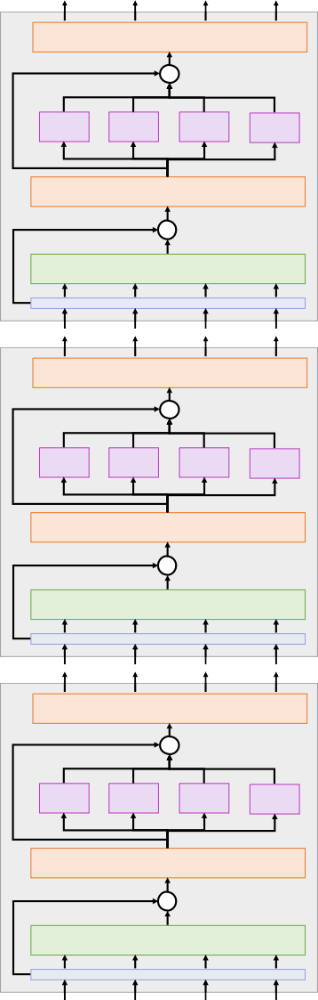
The Transformer
Layer Normalization
+
MLP
MLP
MLP MLP
Transformer Block:
Layer Normalization
+
Self-Attention
Input: Set of vectors x Output: Set of vectors y
A Transformer is a sequence of transformer blocks
Layer Normalization
+
Self-aEen$on is the only interac$on between vectors!
MLP
MLP
MLP MLP
Vaswani et al:
Layer Normalization
+
Self-Attention
12 blocks, D =512, 6 heads
Q
Layer norm and MLP work independently per vector
Layer Normalization
+
MLP
MLP
MLP MLP
Highly scalable, highly parallelizable
Layer Normalization
+
Self-Attention
Vaswani et al, “AEen$on is all you need”, NeurIPS 2017

Slide 93
The Transformer: Transfer Learning
Layer Normalization
+
MLP
MLP
MLP MLP
“ImageNet Moment for Natural Language Processing”
Layer Normalization
+
Self-Attention
Pretraining:
Layer Normalization
+
Download a lot of text from the internet
MLP
MLP
MLP MLP
Layer Normalization
+
Self-Attention
Train a giant Transformer model for language modeling
Layer Normalization
+
Finetuning:
Fine-tune the Transformer on your own NLP task
MLP
MLP
MLP MLP
Layer Normalization
+
Self-Attention
Devlin et al, "BERT: Pre-training of Deep Bidirec$onal Transformers for Language Understanding", EMNLP 2018
Lecture 13 - 95

Slide 94
Scaling up Transformers
Model | Layers | Width | Heads | Params | Data | Training
Transformer-Base | 12 | 512 | 8 | 65M |  | 8x P100 (12 hours)
Transformer-Large | 12 | 1024 | 16 | 213M |  | 8x P100 (3.5 days)
Vaswani et al, “AEen$on is all you need”, NeurIPS 2017
Justin Johnson

Slide 95
Scaling up Transformers
Model | Layers | Width | Heads | Params | Data | Training
Transformer-Base | 12 | 512 | 8 | 65M |  | 8x P100 (12 hours)
Transformer-Large | 12 | 1024 | 16 | 213M |  | 8x P100 (3.5 days)
BERT-Base | 12 | 768 | 12 | 110M | 13 GB
BERT-Large | 24 | 1024 | 16 | 340M | 13 GB
Devlin et al, "BERT: Pre-training of Deep Bidirectional Transformers for Language Understanding", EMNLP 2018
Justin Johnson

Slide 96
Scaling up Transformers
Model | Layers | Width | Heads | Params | Data | Training
Transformer-Base | 12 | 512 | 8 | 65M |  | 8x P100 (12 hours)
Transformer-Large | 12 | 1024 | 16 | 213M |  | 8x P100 (3.5 days)
BERT-Base | 12 | 768 | 12 | 110M | 13 GB
BERT-Large | 24 | 1024 | 16 | 340M | 13 GB
XLNet-Large | 24 | 1024 | 16 | ~340M | 126 GB | 512x TPU-v3 (2.5 days)
RoBERTa | 24 | 1024 | 16 | 355M | 160 GB | 1024x V100 GPU (1 day)
Yang et al, XLNet: Generalized Autoregressive Pretraining for Language Understanding", 2019
Liu et al, "RoBERTa: A Robustly Optimized BERT Pretraining Approach", 2019
Justin Johnson
Lecture 13 - 98

Slide 97
Scaling up Transformers
Model | Layers | Width | Heads | Params | Data | Training
Transformer-Base | 12 | 512 | 8 | 65M |  | 8x P100 (12 hours)
Transformer-Large | 12 | 1024 | 16 | 213M |  | 8x P100 (3.5 days)
BERT-Base | 12 | 768 | 12 | 110M | 13 GB
BERT-Large | 24 | 1024 | 16 | 340M | 13 GB
XLNet-Large | 24 | 1024 | 16 | ~340M | 126 GB | 512x TPU-v3 (2.5 days)
RoBERTa | 24 | 1024 | 16 | 355M | 160 GB | 1024x V100 GPU (1 day)
GPT-2 | 12 | 768 | ? | 117M | 40 GB
GPT-2 | 24 | 1024 | ? | 345M | 40 GB
GPT-2 | 36 | 1280 | ? | 762M | 40 GB
GPT-2 | 48 | 1600 | ? | 1.5B | 40 GB
Radford et al, "Language models are unsupervised multitask learners", 2019
Justin Johnson
Lecture 13 - 99

Slide 98
Scaling up Transformers
Model | Layers | Width | Heads | Params | Data | Training
Transformer-Base | 12 | 512 | 8 | 65M |  | 8x P100 (12 hours)
Transformer-Large | 12 | 1024 | 16 | 213M |  | 8x P100 (3.5 days)
BERT-Base | 12 | 768 | 12 | 110M | 13 GB
BERT-Large | 24 | 1024 | 16 | 340M | 13 GB
XLNet-Large | 24 | 1024 | 16 | ~340M | 126 GB | 512x TPU-v3 (2.5 days)
RoBERTa | 24 | 1024 | 16 | 355M | 160 GB | 1024x V100 GPU (1 day)
GPT-2 | 12 | 768 | ? | 117M | 40 GB
GPT-2 | 24 | 1024 | ? | 345M | 40 GB
GPT-2 | 36 | 1280 | ? | 762M | 40 GB
GPT-2 | 48 | 1600 | ? | 1.5B | 40 GB
Megatron-LM | 40 | 1536 | 16 | 1.2B | 174 GB | 64x V100 GPU
Megatron-LM | 54 | 1920 | 20 | 2.5B | 174 GB | 128x V100 GPU
Megatron-LM | 64 | 2304 | 24 | 4.2B | 174 GB | 256x V100 GPU (10 days)
Megatron-LM | 72 | 3072 | 32 | 8.3B | 174 GB | 512x V100 GPU (9 days)
Shoeybi et al, "Megatron-LM: Training Multi-Billion Parameter Languge Models using Model Parallelism", 2019
Justin Johnson

Slide 99
Scaling up Transformers
~$430,000 on Amazon AWS!
Model | Layers | Width | Heads | Params | Data | Training
Transformer-Base | 12 | 512 | 8 | 65M |  | 8x P100 (12 hours)
Transformer-Large | 12 | 1024 | 16 | 213M |  | 8x P100 (3.5 days)
BERT-Base | 12 | 768 | 12 | 110M | 13 GB
BERT-Large | 24 | 1024 | 16 | 340M | 13 GB
XLNet-Large | 24 | 1024 | 16 | ~340M | 126 GB | 512x TPU-v3 (2.5 days)
RoBERTa | 24 | 1024 | 16 | 355M | 160 GB | 1024x V100 GPU (1 day)
GPT-2 | 12 | 768 | ? | 117M | 40 GB
GPT-2 | 24 | 1024 | ? | 345M | 40 GB
GPT-2 | 36 | 1280 | ? | 762M | 40 GB
GPT-2 | 48 | 1600 | ? | 1.5B | 40 GB
Megatron-LM | 40 | 1536 | 16 | 1.2B | 174 GB | 64x V100 GPU
Megatron-LM | 54 | 1920 | 20 | 2.5B | 174 GB | 128x V100 GPU
Megatron-LM | 64 | 2304 | 24 | 4.2B | 174 GB | 256x V100 GPU (10 days)
Megatron-LM | 72 | 3072 | 32 | 8.3B | 174 GB | 512x V100 GPU (9 days)
Shoeybi et al, "Megatron-LM: Training Multi-Billion Parameter Languge Models using Model Parallelism", 2019
Justin Johnson

Slide 100
PROMPT (Human-written): In a shocking finding, scientist discovered a herd of unicorns living in a remote, previously unexplored valley, in the Andes Mountains. Even more surprising to the researchers was the fact that the unicorns spoke perfect English.
OpenAI, “Better Language Models and their Implications”, 2019, https://openai.com/blog/better-language-models/
Justin Johnson

Slide 101
PROMPT (Human-written): In a shocking finding, scientist discovered a herd of unicorns living in a remote, previously unexplored valley, in the Andes Mountains. Even more surprising to the researchers was the fact that the unicorns spoke perfect English.
COMPLETION (Transformer-written): The scientist named the population, after their distinctive horn, Ovid’s Unicorn. These four- horned, silver-white unicorns were previously unknown to science.
Now, after almost two centuries, the mystery of what sparked this odd phenomenon is finally solved.
Dr. Jorge Pérez, an evolutionary biologist from the University of La Paz, and several companions, were exploring the Andes Mountains when they found a small valley, with no other animals or humans. Pérez noticed that the valley had what appeared to be a natural fountain, surrounded by two peaks of rock and silver snow.
Pérez and the others then ventured further into the valley. “By the time we reached the top of one peak, the water looked blue, with some crystals on top,” said Pérez.
Pérez and his friends were astonished to see the unicorn herd. These creatures could be seen from the air without having to move too much to see them – they were so close they could touch their horns.
While examining these bizarre creatures the scientists discovered that the creatures also spoke some fairly regular English. Pérez stated, “We can see, for example, that they have a common ‘language,’ something like a dialect or dialectic.”
Dr. Pérez believes that the unicorns may have originated in Argentina, where the animals were believed to be descendants of a
lost race of people who lived there before the arrival of humans in those parts of South America.
While their origins are still unclear, some believe that perhaps the creatures were created when a human and a unicorn met each
other in a time before human civilization. According to Pérez, “In South America, such incidents seem to be quite common.” However, Pérez also pointed out that it is likely that the only way of knowing for sure if unicorns are indeed the descendants of a lost alien race is through DNA. “But they seem to be able to communicate in English quite well, which I believe is a sign of evolution, or at least a change in social organization,” said the scientist.
OpenAI, “Better Language Models and their Implications”, 2019, https://openai.com/blog/better-language-models/
Justin Johnson

Slide 102
PROMPT (Human-written): In a shocking finding, scientist discovered a herd of unicorns living in a remote, previously unexplored
valley, in the Andes Mountains. Even more surprising to the researchers was the fact that the unicorns spoke perfect English. COMPLETION (Transformer-written): The scientist named the population, after their distinctive horn, Ovid’s Unicorn. These four- horned, silver-white unicorns were previously unknown to science.
Now, after almost two centuries, the mystery of what sparked this odd phenomenon is finally solved.
Dr. Jorge Pérez, an evolutionary biologist from the University of La Paz, and several companions, were exploring the Andes
Mountains when they found a small valley, with no other animals or humans. Pérez noticed that the valley had what appeared be a natural fountain, surrounded by two peaks of rock and silver snow.
Pérez and the others then ventured further into the valley. “By the time we reached the top of one peak, the water looked blu ith some crystals on top,” said Pérez.
érez and his friends were astonished to see the unicorn herd. These creatures could be seen from the air without having to ove too much to see them – they were so close they could touch their horns.
hile examining these bizarre creatures the scientists discovered that the creatures also spoke some fairly regular English. Pére tated, “We can see, for example, that they have a common ‘language,’ something like a dialect or dialectic.”
to
Try it yourself: https://talktotransformer.com
e,
w P
m
W
s
z
Dr. Pérez believes that the unicorns may have originated in Argentina, where the animals were believed to be descendants of a lost race of people who lived there before the arrival of humans in those parts of South America.
While their origins are still unclear, some believe that perhaps the creatures were created when a human and a unicorn met each
other in a time before human civilization. According to Pérez, “In South America, such incidents seem to be quite common.” However, Pérez also pointed out that it is likely that the only way of knowing for sure if unicorns are indeed the descendants of a lost alien race is through DNA. “But they seem to be able to communicate in English quite well, which I believe is a sign of evolution, or at least a change in social organization,” said the scientist.
OpenAI, “Better Language Models and their Implications”, 2019, https://openai.com/blog/better-language-models/
Justin Johnson

Slide 103
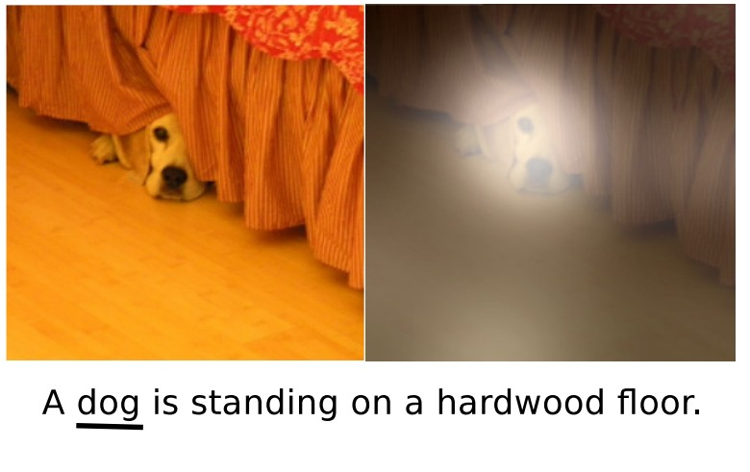
Summary
Generalized Self-Attention is new, powerful neural network primitive
Transformers are a new neural network model that only uses attention
Adding Attention to RNN models lets them look at different parts of the input at each timestep
Y₁
Y₂
Y₃
y₁
y₂
y₃
y₄
Product(→), Sum(↑)
Layer Normalization
V₃
^{A}1,3 ^{A}2,3 ^{A}3,3
^{A}1,2 ^{A}2,2 ^{A}3,2
^{A}1,1 ^{A}2,1 ^{A}3,1
Softmax(↑)
^{E}1,3 ^{E}2,3 ^{E}3,3
^{E}1,2 ^{E}2,2 ^{E}3,2
^{E}1,1 ^{E}2,1 ^{E}3,1
Q₁ Q₂ Q₃
X₁ X₂ X₃
V₂
+
V₁
MLP
MLP
MLP
MLP
K₃
Layer Normalization
K₂
+
K₁
Self-Attention
x₁
x₂
x₃
x₄
Xu et al, “Show, Attend, and Tell: Neural Image Caption Generation with Visual Attention”, ICML 2015
Justin Johnson

